Slide 1
ICU CURRICULUM
ACUTE LIVER FAILURE

Slide 2
Clinical Case
23-year-old female presented to outside hospital with nausea and diffuse abdominal pain for 3 days. Transferred to AHO for acute liver failure workup.
BP 100/60 HR 80 RR 28 Temp 100.1 SpO2 96% on RA
Gen: no acute distress
Neuro: drowsy, but wakes up to answer questions, mild confusion, oriented to person, place, and year, PERRL, no asterixis, moves all extremities
HEENT: + scleral icterus
Cardiac: regular rhythm
Lungs: tachypneic, clear to auscultation bilaterally
Abdomen: soft, tender to palpation in RUQ, + hepatomegaly
Extremities: no lower extremity edema
Skin: + jaundice

Slide 3
Initial Labs
11.8
124
93
6.0
9.69
100
65
5.5
10
1.4
PT >100
INR >18.92
APTT 43.1
AST >7,000
ALT >7,000
ALP 271
Tprot 5.5
Albumin 3.0
Total bili 8.5

Slide 4
Additional history
PMH: asthma
PSH: none
FH: adopted, unknown
SH: never smoker, rarely drinks EtOH, no illicits
Works as a teacher
Per mother, progressive fatigue for 5 days, nausea, vomiting, and headaches. She was taken 2 extra strength Tylenol tablets 2-3 times per day for the past 3 days. Had a URI 3 weeks ago, prescribed Amoxicillin by PCP. Recently went to SeaWorld. No other travel.

Slide 5
Differential for acute liver failure
Shock liver
Acetaminophen
Drug toxicity
Substance abuse
Viral [Hepatitis, CMV, EBV, adenovirus, HIV, HSV, parvovirus]
Autoimmune
HELLP
Malignancy [infiltrating tumor, VTE]
Budd Chiari
Wilson’s disease

Slide 6
Additional labs/workup
ABG
Lactic acid
Salicylates
Acetaminophen
Hepatitis panel
HIV
EBV, CMV, HSV, Parvovirus, adenovirus
Ceruloplasmin
ANA
Anti-smooth muscle antibody
Ethanol
Urine tox screen
Ammonia
Ferritin
Serum osmolality
Urinalysis
Blood/urine cultures
Peripheral smear
Serum osmolality
CXR
RUQ US with Doppler

Slide 7
Results
ABG: pH 7.40/ pCO2 21.1 / PaO2 66.9 / CO2 13.1
Lactic acid 21
Acetaminophen <10
Salicyclates 0.5
Ethanol <10
Ammonia 153
CMV IgM negative
EBV IgG 2.1; viral capsid- positive (>1.0 positive)
EBV IgM 1.7; viral capsid- positive
EBV Quant PCR 64,402
Hepatitis panel, HIV, HSV- negative
RUQ US w/ Doppler: patent hepatic and portal vasculature

Slide 8
Diagnoses
Acute liver failure due to EBV hepatitis
Coagulopathy, mild hepatic encephalopathy
AKI
Lactic acidosis
Hyponatremia
Hyperkalemia

Slide 9
Definition of Acute Liver Failure
Interchangeable with fulminant hepatic failure
Presence of encephalopathy (regardless of grade!)
AND
Coagulopathy (INR >1.5)
Within 26 weeks of the appearance of symptoms in patients with no previous history of underlying liver disease

Slide 10
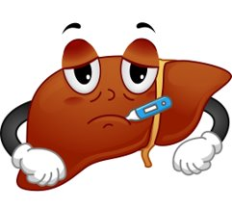
Clinical Features of Acute Liver Failure
N Engl J Med 2013; 369:2525-2534

Slide 11
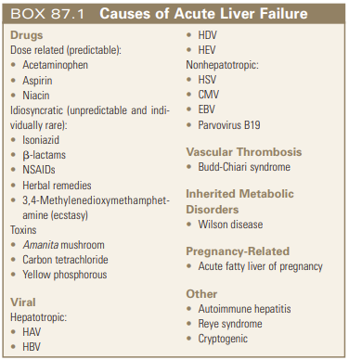
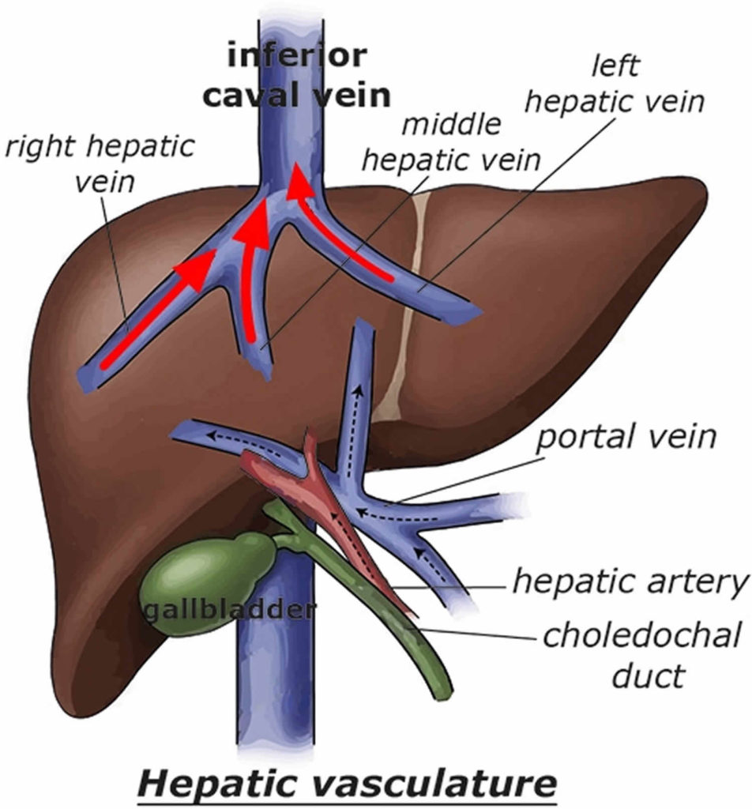
Etiology
Hepatic vein outflow obstruction (1 vein thrombosed usually silent)
Treatment??
High dose penicillin competes with liver uptake of amanita toxin

Slide 12
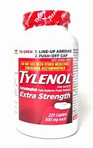
King's College Criteria

Slide 13
Management
What should be done next?
Consult Hepatology
Obtain a CT abd/pelvis with contrast to evaluate for other causes of liver failure
Start NAC therapy, dextrose-containing fluid, and neurochecks q1h
Obtain a stat CT head to evaluate for cerebral edema

Slide 14
Management
What should be done next?
Consult Hepatology
Obtain a CT abd/pelvis with contrast to evaluate for other causes of liver failure
Start NAC therapy, dextrose-containing fluid, and neuro checks q1h
Obtain a stat CT head to evaluate for cerebral edema

Slide 15
Management of ALF
Treat specific cause:
Acetaminophen -> NAC
HBV -> Nucleoside analogue
HSV -> Acyclovir
AFLP -> emergency delivery
Budd Chiari -> Catheter-directed thrombolysis or TIPS
AIH -> high-dose steroids
Hepatic encephalopathy
Cerebral edema
Intracranial hypertension
Coagulopathy
Discussed later:
Vasodilatory shock​
Renal failure​
Respiratory failure​
Infection/Sepsis​
Metabolic derangements​

Slide 16
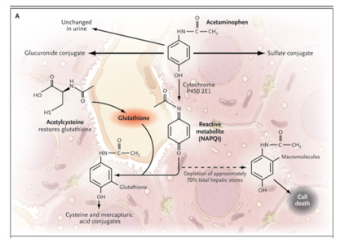
N-acetylcysteine (NAC) dosing
Loading dose of 150 mg/kg over 60 minutes
Second dose - infusion of 12.5mg/kg over 4 hours
Third dose - infusion of 6.25 mg/kg over 16 hours
In those patients with fulminant hepatic failure, final infusion rate can be continued until the patient receives a liver transplant or hepatic encephalopathy resolves.
N Engl J Med 2008; 359: 385-292

Slide 17
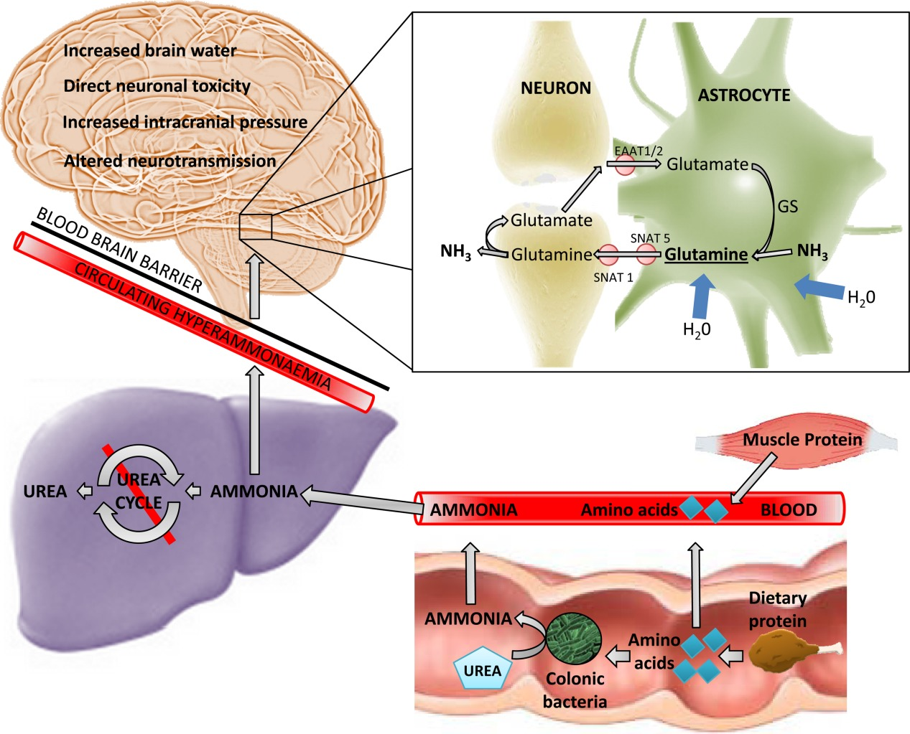
Hepatic encephalopathy
Multifactorial but most likely due to systemic and local inflammation, and circulating neurotoxins, namely ammonia.
Leads to astrocyte swelling and can progress to cerebral edema
Ammonia > 150 µmol/L is associated with intracranial HTN

Slide 19
Management of cerebral edema
Mannitol
Hypertonic saline
Goal Na 145-155
ICP monitoring:
ICP <20
Cerebral perfusion pressure >50-60 mmHg
CPP = MAP – ICP
Avoid fevers
Little evidence for use of lactulose in setting of ALF

Slide 20
Other Neuroprotective Strategies
Deep sedation
Indomethacin – limited evidence in humans
Anticonvulsants only if clinically evident or EEG-proven
Molecular adsorbent reticulation system (MARS)
"Liver dialysis"
Effectively removes albumin-bound toxins and improves encephalopathy but...
It has NOT been shown to improve survival

Slide 21
Coagulopathy
INR is not a reliable guide to bleeding tendency.
Avoid treating isolated derangements.
Utilize TEG if the patient is bleeding.
Avoid extreme hypofibrinogenemia and thrombocytopenia.
Prophylactic FFP is NOT recommended before most procedures.

Slide 22
Management of ALF
Management of other common ICU problems are similar in ALF patients, including vasodilatory shock, renal failure, respiratory failure, infection, and metabolic derangements.
Some extra points to think about...
Patients with high-grade encephalopathy (3 or 4) should be intubated for airway protection
Hypoglycemia due to failure of gluconeogenesis
Hyponatremia – associated with worse outcomes
Severe susceptibility to bacterial and fungal infections, such as Candida.
Avoid strongly positive fluid balance

Slide 23
Emergency Liver Transplantation (ELT)
The only single intervention proven to reduce mortality in ALF
Contraindications to ELT:
Malignancy
Irreversible neurologic injury
Uncontrolled sepsis

Slide 24
References
Lee, W. M., Hynan, L. S., Rossaro, L., Fontana, R. J., Stravitz, R. T., Larson, A. M., et al. (2009). Intravenous N-acetylcysteine improves transplant-free survival in early stage non-acetaminophen acute liver failure. Gastroenterology, 137(3), 856–864
Murphy, N., Auzinger, G., Bernel, W., & Wendon, J. (2004). The effect of hypertonic sodium chloride on intracranial pressure in patients with acute liver failure. Hepatology, 39(2), 464–470
Tofteng, F., & Larsen, F. S. (2004). The effect of indomethacin on intracranial pressure, cerebral perfusion and extracellular lactate and glutamate concentrations in patients with fulminant hepatic failure. Journal of Cerebral Blood Flow and Metabolism, 24(7), 798–804
Vaid A, Chweich H, Balk EM, Jaber BL. Molecular adsorbent recirculating system as artificial support therapy for liver failure: a meta-analysis. ASAIO J. 2012;58(1):51-9.
Vincent, J. L., Moore, F. A., Bellomo, R., Marini, J. (2024). Textbook of Critical Care (8th ed.). Elsevier.
Warrillow, S., Fisher, C., Tibballs, H., Bailey, M., McArthur, C., LawsonSmith, P., et al. (2020). Coagulation abnormalities, bleeding, thrombosis, and management of patients with acute liver failure in Australia and New Zealand. Journal of Gastroenterology and Hepatology, 35, 846–854
Warrillow, S. (2017). Life on MARS? Critical Care Medicine, 45(10), 1776–1777.

