Slide 1
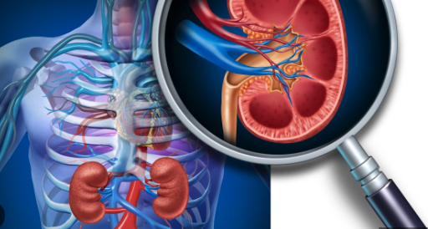
ICU CURRICULUM
Acute Kidney Injury

Slide 2
Renal Physiology
Blood flow to the kidney is tightly controlled by sophisticated autoregulatory mechanisms, which preserve the GFR and renal oxygen delivery across a range of systemic arterial pressures.
Because energy is required for the active reabsorption of solutes, renal function is dependent on metabolism and the kidney is prone to hypoxic, ischemic, and oxidative injury.
AKI = abrupt reduction in GFR because of one or more insults that damage tubular epithelial and vascular endothelial cells and disrupt mitochondrial function.

Slide 3
Acute Kidney Injury
AKI is a common complication in hospitalized and critically ill patients
Associated with high mortality and increases the risk of developing chronic comorbidities
Traditionally categorized based on anatomic location of insult (prerenal, intrinsic, and postrenal).
However, AKI occurs on a spectrum of pathophysiologic insults, thereby giving way to descriptive syndromes:
Sepsis-associated AKI
Nephrotoxic AKI
Cardiorenal syndrome
Hepatorenal syndrome
AKI in Rhabdomyolysis

Slide 4
Biomarkers of Kidney Function and Acute Kidney Injury
Creatine Clearance (C_{Cr})– overestimates GFR, especially at GFR < 40
Serum Creatinine – depends on method of measurement
Cockcroft-Gault equation – accuracy is similar to or greater than 24-h C_{Cr} with better precision
MDRD equation – generally more precise than Cockcroft-Gault excpet at high GFRs (>60)
Serum Cystatin C – recently emerged as an alternative GFR biomarker as an independent risk factor for AKI as well as a predictor for the need of RRT
NGAL – another biomarker of AKI in critically ill patients

Slide 5
New Equations Used to Estimate eGFR without the use of Race

Slide 6
The predictive value of urine NGAL, plasma NGAL, and serum cystatin C to differentiate among sustained, transient, and absent AKI was compared in 700 ICU patients in a prospective cohort study.
Urine NGAL was the only biomarker that could significantly differentiate sustained from transient AKI on ICU admission.
Meta-analysis including more than 13,000 pts to predict AKI and RRT
Conclusion: Identified urinary and plasma NGAL cutoff concentrations may indicate patients at high risk for AKI in clinical research and practice but require prospective validation.
Nephron Extra. 2011 Jan-Dec; 1(1): 9–23.
Am J Kidney Dis. 2020 Dec;76(6):826-841.e1.

Slide 8
Kidney Disease: Improving Global Outcomes (KDIGO) Staging of AKI
Sepsis is well recognized as the leading cause of AKI in the critically ill
On the contrary, AKI may increase the risk of sepsis
Mehta et al demonstrated that 40% of critically ill patients develop sepsis after AKI; Intensive Care Medicine, 37, 241–248.

Slide 9
Stage-based management of AKI

Slide 10
Clinical Case
44 year old male with history of diabetes and alcohol abuse presents to the ER with abdominal pain, nausea, vomiting.
BP: 80/40 HR: 120 RR: 28 Temp: 99 Sp02: 96% on RA
Gen: drowsy, but wakes up to answer questions
Cardiac: regular rhythm, tachycardic
Lungs: clear to auscultation bilaterally
Abdomen: TTP in epigastric area
Extremities: no lower extremity edema

Slide 11
Labs
Prot
7.2
T-bili
2.3
AST
3205
129
79
25
220
Alk Phos 215
Alb
3.6
ALT
2546
3.7
<5
5.94
10.6
107
Lactate 24
INR 2.8
8.4
Anion Gap = [Na⁺] – [Cl⁻] – [HCO3⁻]
Anion Gap = 45
Delta: Delta = 33:19 = 1.7 (pure AGMA)
pH: 6.84 | PCO2 15 | PO2: 90​

Slide 12
Additional Results
CXR – no infiltrates
EKG – sinus tachycardia
UA – muddy brown casts
Blood/urine cultures pending
Ethanol – 13
Urine tox screen – negative
Magnesium – 2.3 Phosphorus – 15.4
Serum osmolality – 286 [275-300]

Slide 13
Diagnoses and Management
Problem List:
High anion gap metabolic acidosis
Lactic acidosis
Acute kidney injury
Acute liver failure
Hyponatremia
Initial Management:
IV access
IV fluids
Bicarbonate?
Dialysis
Thiamine
Insulin/Glucose

Slide 14
Clinical question
The patient received 3L normal saline in the ED, but because he was still hypotensive, he was started on vasopressor therapy prior to transfer. A bedside ultrasound shows that there is >50% collapsibility of the IVC with inspiration. In addition to continuing IV fluid resuscitation, what should be done next?
Start an infusion of sodium bicarbonate and repeat BMP + ABG in 4 hours
Place a dialysis catheter and start intermittent hemodialysis
Place a dialysis catheter and start continuous renal replacement therapy
Start an insulin drip and repeat a BMP in 4 hours

Slide 15
Additional work up for AKI
Pre renal and ATN are the most common reasons for AKI in ICU setting
FeNa/FeUrea
UA
CK to evaluate for rhabdomyolysis
Bladder scan/foley placement
Abdominal imaging to evaluate for obstruction
Urine eosinophils to evaluate for AIN
Uric acid (tumor lysis syndrome)

Slide 16
Indications for dialysis
Acidosis (pH < 7.1)
Electrolyte abnormalities (hyperkalemia)
Ingestion
Overload (Refractory volume overload)
Uremia (encephalopathy, pericarditis)

Slide 17
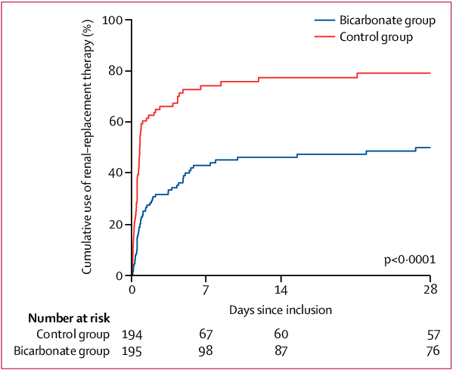
BICAR-ICU Trial
Cumulative use of RRT from enrollment to day 28 in the overall population

Slide 18
Landmark Trials: Timing of Renal Replacement Therapy (RRT)
Early vs Late initiation of RRT has been studied for decades with mixed results.
The 2 most recent trials:
STARRT-AKI (2020)
AKIKI-2 (2021)
BOUMAN

Slide 19
AKIKI-2 Trial

Slide 20
Dialysis
Intermittent hemodialysis
High efficiency of transport of solutes when rapid clearance of toxins or electrolytes is required
Difficult to complete with hemodynamic instability
CRRT [continuous renal replacement therapy]
Steady solute control
Less likely to cause hemodynamic shifts
May require anticoagulation
Need HD catheter even if patient has AV fistula/graft
SLED [sustained low efficiency dialysis]
Intermittent [8-10 hours/session]
Lower small solute and fluid removal than IHD
Higher small solute and fluid removal than CRRT

Slide 21
The CRRT Players
Diffusion: movement of molecules down a concentration gradient (high-to-low)
Clears small molecules (Na, K, Cr, urea)
Convection: solutes move and pull water across a membrane as a result of transmembrane pressure gradient (”solvent drag”)
Better for clearance of middle molecules (vit B12, B2-macroglobulin, kappa light chains)
Notes:
CVVH utilizes convection. Replacement fluid is administered to maintain euvolemia and dilute the plasma concentration of solutes not present in the replacement fluid (i.e. urea nitrogen, creatinine).
CVVHD utilizes diffusion and convection. Replacement fluid is not used in CVVHD.
CVVHDF uses a combination of convection and diffusion. Replacement fluid is also used to maintain euvolemia as in CVVH.
middle molecules: vitamin B12, b2 microglobulin, kappa light chains
not middle molecules: urea, creatinine (too small); albumin (too large)

Slide 22
Chest 2007; 132: 1379-1388

Slide 23
Clinical question
The patient received 5L normal saline in the ER, but because he was still hypotensive, he was started on vasopressor therapy prior to transfer. A bedside ultrasound shows that there is >50% collapsibility of the IVC with inspiration. In addition to continuing IV fluid resuscitation, what should be done next?
Start an infusion of sodium bicarbonate and repeat BMP + ABG in 4 hours
Place a dialysis catheter and start intermittent hemodialysis
Place a dialysis catheter and start continuous renal replacement therapy
Start an insulin drip and repeat a BMP in 4 hours

Slide 24
Clinical question
The patient received 5L normal saline in the ER, but because he was still hypotensive, he was started on vasopressor therapy prior to transfer. A bedside ultrasound shows that there is >50% collapsibility of the IVC with inspiration. In addition to continuing IV fluid resuscitation, what should be done next?
Start an infusion of sodium bicarbonate and repeat BMP + ABG in 4 hours
Place a dialysis catheter and start intermittent hemodialysis
Place a dialysis catheter and start continuous renal replacement therapy
Start an insulin drip and repeat a BMP in 4 hours
It would also be reasonable to start a sodium bicarb drip to serve as further resuscitation, improve the acidemia, and even potentially avoid or delay RRT.

Slide 25
Summary
Prerenal and ATN are most common causes of AKI
Evaluate for obstruction
Place dialysis catheter if planning for dialysis
Renal dosing of medications
No mortality difference in IHD vs CRRT

Slide 26
Further Information
Summary of KDIGO Recommendation Statements: Prevention and Treatment of AKI
Summary of KDIGO Recommendation Statements: Contrast-Induced AKI
Chest 2007; 132: 1379-1388

