Slide 1
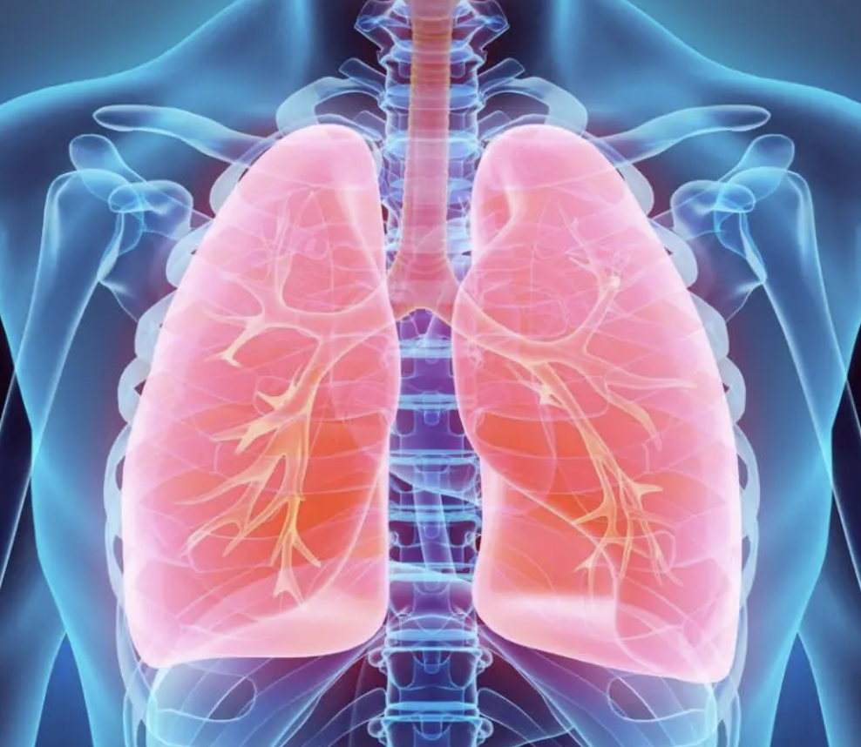

ICU
CURRICULUM
Acute Respiratory Distress Syndrome
(ARDS)

Slide 2
Clinical Case
35 year old female with history of diabetes and obesity who was admitted to an outside hospital with 1 week of cough and shortness of breath. She was intubated there and transferred here for further management of her hypoxemic respiratory failure.
BP: 130s/80s HR: 120 RR: 28 Temp: 100 Sp02: 80% on 100% Fi02
VC: RR 20 | Tidal volume 500 | PEEP: 16 | Fi02: 100%
PIP 50, inspiratory pause -> Plateau pressure 35, expiratory pause -> PEEP 20

Slide 3
Initial Labs
Pro
7.7
T-bil 0.9
AST
34
135 | 99 | 15
---------------- < 160
4.8 | 22 | 1.0
Calcium: 9
BNP: 50
Respiratory viral panel: pending
Alk Phos 83
Alb
3.8
ALT 31
pH: 7.30 | PCO2: 48 | PO2: 50

Slide 4
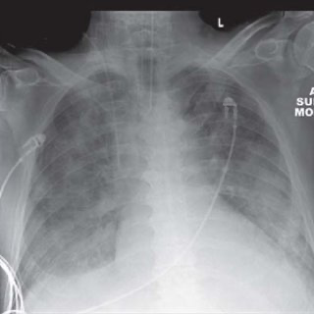

Slide 5
Differential Diagnosis
Noncardiogenic pulmonary edema/ARDS
Infection
Left heart failure
Diffuse alveolar hemorrhage
Acute eosinophilic pneumonia
Acute interstitial pneumonia
Pulmonary alveolar proteinosis
Organizing pneumonia
Hypersensitivity pneumonitis
Leukemic infiltration
Drug toxicity
Aspiration
TRALI
Fat embolism

Slide 6
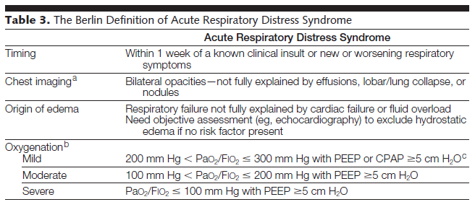
Berlin Classification
JAMA. 2012;307(23):2526-2533

Slide 7
Precipitating Causes
ARDS is a final common pathway to a wide range of precipitants.
Can divide precipitating causes into 2 groups:
  Direct (pulmonary)
  Indirect (extrapulmonary)
Pulmonary Causes | Extrapulmonary Causes
Bacterial pneumonia | Acute pancreatitis
Viral pneumonia | TRALI
Aspiration of gastric contents | Post cardiopulmonary bypass
Trauma with lung contusion | Severe sepsis
Near drowning | Toxic ingestions
Pneumocystis pneumonia | Bone marrow transplant
Smoke inhalation | Burns
Crack lung
Fat embolism

Slide 8
Clinical question
She is sedated with fentanyl and midazolam and you decrease her tidal volume, allowing for permissive hypercapnia. She continues to be hypoxemic. Which additional measure has been shown to have a mortality benefit in patients with severe ARDS?
  Inhaled pulmonary vasodilator therapy [NO or Flolan]
  Prone ventilation
  BiLevel/Airway Pressure Release Ventilation
  Higher PEEP strategy

Slide 9
Initial management
CXR, ABG
Adequate sedation
Low tidal volumes
Permissive hypercapnia
PEEP
Steroids
Paralysis
Pulmonary vasodilators
Empiric treatment for Influenza
Broad spectrum antibiotics

Slide 10
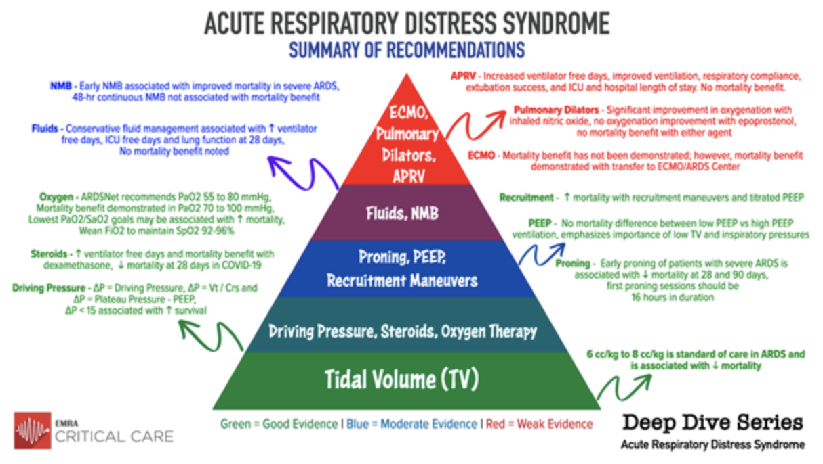

Slide 11
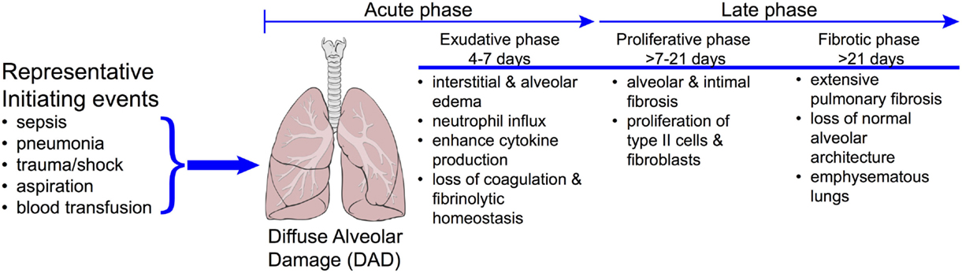
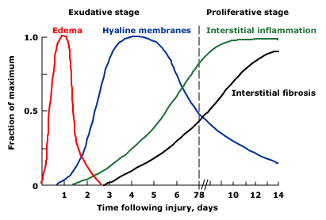
Pathogenesis and Pathology

Slide 12
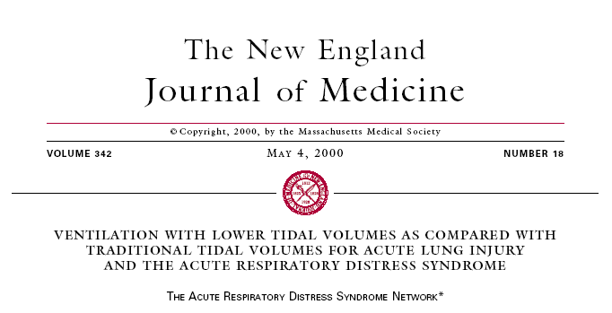
ARDSNET Trial
multicenter randomized control trial, 861 adult patients in ARDS
traditional ventilation (initial tidal volume of 12 mL/kg and Pplat <50 cm H2O)
vs
lower tidal volume ventilation (initial tidal volume of 6 mL/kg and Pplat <30 cm H2O).
BOTTOM LINE:
  Lung protective ventilation utilizing a lower tidal volume strategy reduces mortality and increases ventilator-free day

Slide 13
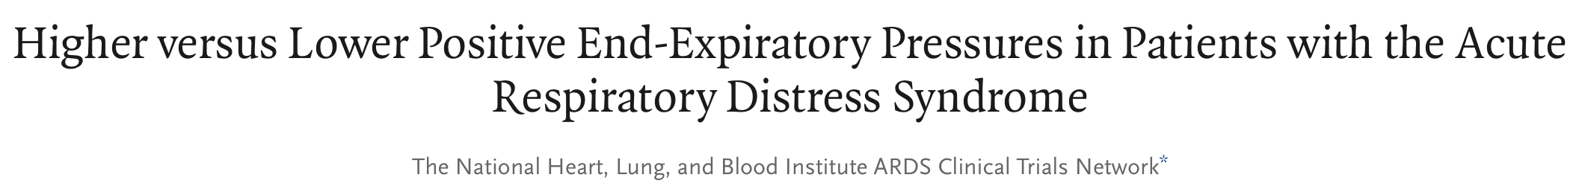
PEEP in ARDS
NEJM 2004; 351:327-336
Helps decrease requirements for high FiO₂ by alveolar recruitment
Ideal level of PEEP is based on the individual patient.
Beneficial effects:
  recruitment, improved oxygenation
Detrimental effects:
  over distention, barotrauma, decreased venous return with decrease cardiac output.
Multicenter randomized control trial, comparing low vs high PEEP strategy in pts with ARDS
Both groups used 6mL/kg TV and Pplat <30 cmH20 goal
Conclusions: No mortality difference between low vs high PEEP strategy, further emphasizing low TV and low inspiratory pressures

Slide 14
178 patients randomized to 48 hours of cisatracurium and 162 to placebo
Median time from diagnosis of ARDS to study inclusion was 16 hours
The ACURASYS trial showed paralysis with cisatracurium for 48h had favorable results on survival to hospital discharge, lower rates of mortality within 90 days**, and increased rate of vent-free days.
**Caveat: compare to the ROSE trial, which did NOT demonstrate any significant difference in 28-day or 90-day mortality

Slide 15
NEJM 2006 ; 354: 2564
Conservative mgmt targeted CVP <4
Liberal fluid mgmt targeted CVP 10-14
No mortality difference at 60 days
The FACTT trial demonstrated that conservative fluid strategy was associated with significantly greater vent-free days, improved measures of lung function, and fewer ICU days

Slide 16
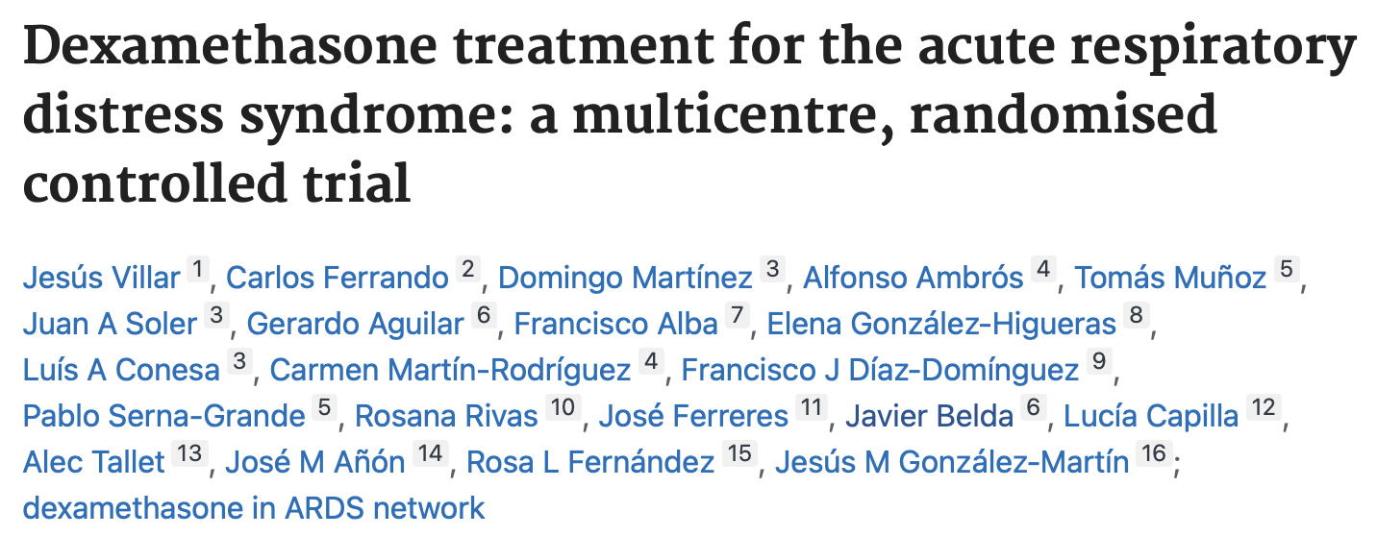
17 ICUs in Spain
Moderate-to-severe ARDS, PF <200 with FiO2≥ 50% and PEEP ≥ 10 at 24h after ARDS onset
Intervention: IV dexamethasone 20mg once daily x 5 days followed by 10mg once daily for 5 days
Largest RCT done investigating corticosteroids in moderate-to-severe ARDS
Trial stopped early due to low enrollment rate (277 of planned 314 patients)
The DEXA-ARDS trial suggests an increase in ventilator-free days and mortality benefit with dexamethasone in addition to standard ARDS treatment strategies (NNT = 7)
Lancet Respir Med. 2020 Mar;8(3):267-276.

Slide 17
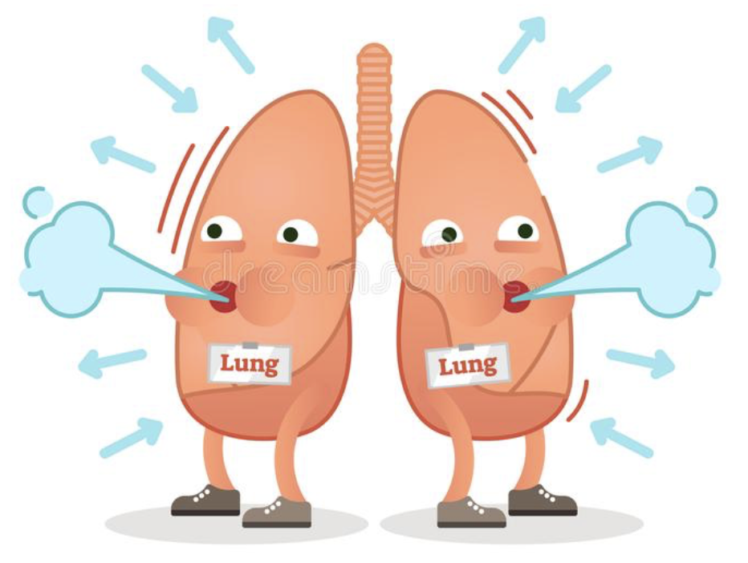
Inhaled pulmonary vasodilators
  Induces selective vasodilatation in ventilated lung areas and redistributes blood flow
  Reduces pulmonary hypertension
  Improves oxygenation in the first 24 hours
  No randomized trials that show a mortality benefit
  Should not be abruptly stopped; wean by 50%
  Nitric oxide
    Usual dose is 20 parts per million [ppm]
  Epoprostenol (Flolan)
    Starting dose is 20,000 ng/mL

Slide 18
Prone Therapy
Decreases shunt perfusion
Improves V/Q matching
Improves oxygenation
Difficult to care for catheters and ETT
Concern for development of pressure ulcers and facial edema
Need for increased sedation

Slide 19
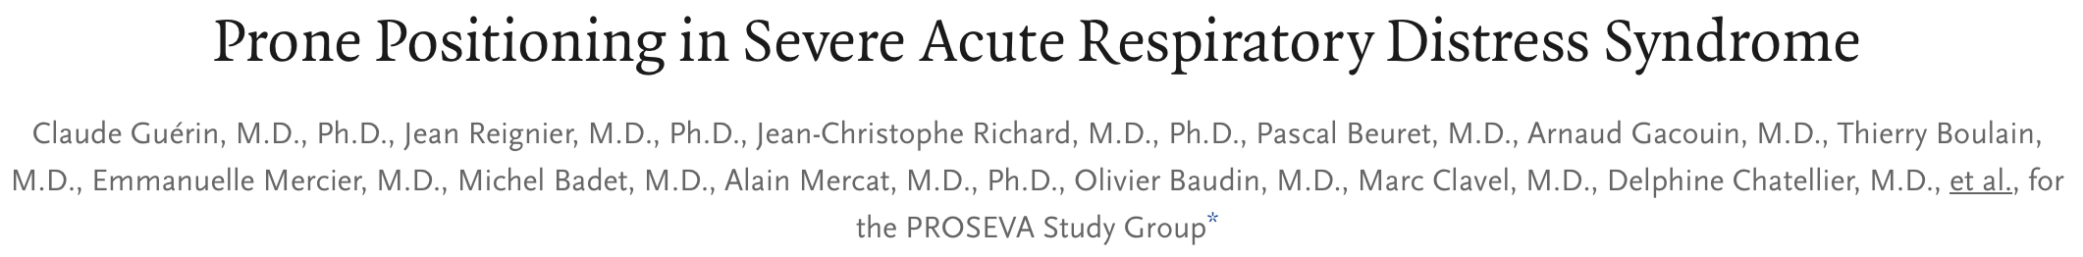
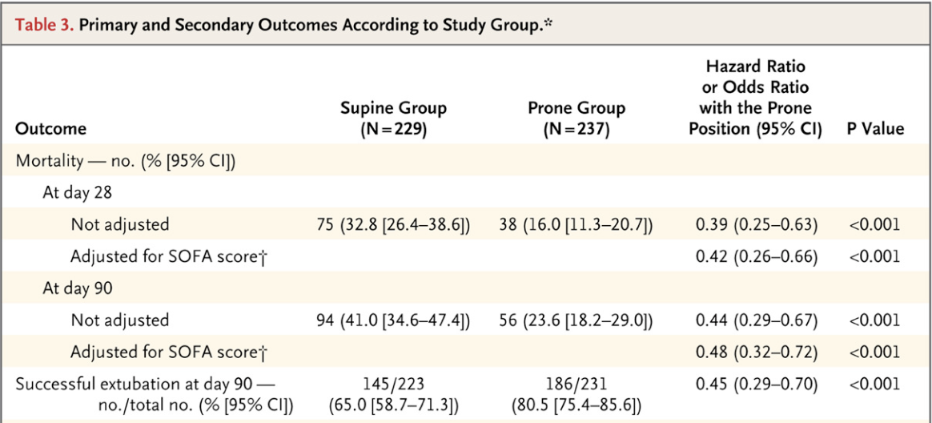
Multicenter, prospective, randomized, controlled trial
466 pts with severe ARDS (defined as PF <150 with FiO2 ≥ 60% and PEEP ≥ 5 and a TV close to 6mL/kg PBW)
Prone x 16 hours vs Supine
The PROSEVA trial demonstrated that placing patients with severe ARDS in the prone-position significantly decreased 28-day and 90-day mortality

Slide 20
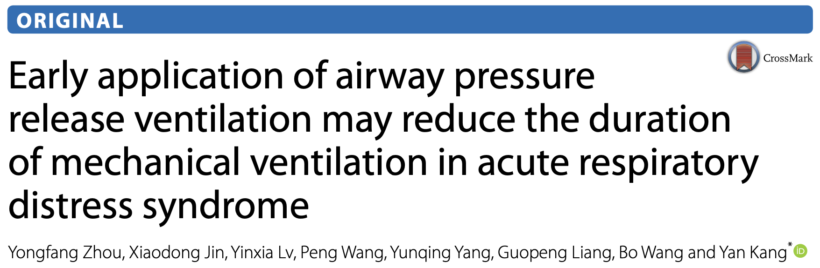
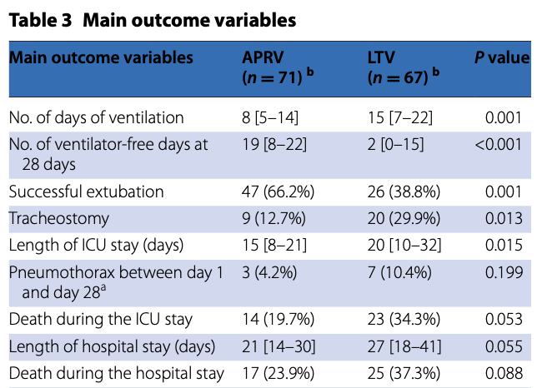
Single-centered RCT, 138 adult patients examining APRV vs lung protective ventilation in pts with ARDS
P_{high} = plateau on volume control settings, P_{low} = 5
Early application included <48h since intubation
Notable exclusions: severe COPD, expecteed 6-mo mortality >50%, pts >85yo
Zhou et al demonstrated that early application of APRV compared to LTV, improved oxygenation and respiratory system compliance, decreased Pplat and decreased vent and ICU LOS.
No mortality difference.
Intensive Care Med. 2017; 43(11): 1648–1659.

Slide 21
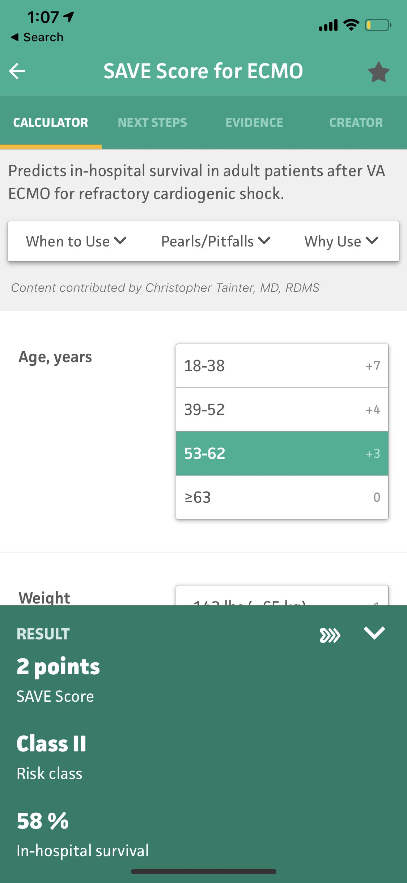
ECMO
Indications for consideration of VV-ECMO in acute respiratory failure:
  Potentially reversible, single organ (lung) disease (AKI not a contraindication)
  PF < 50 for > 3 hours despite ventilator optimization and use of adjunctive measures OR
  PF < 80 for > 6 hours despite attempted optimization OR
  pH < 7.20 with predominantly respiratory component despite attempted optimization OR
  Plateau pressure persistently >30 despite attempted optimization
(Relative) Contra-indications:
  Poor pre-ECMO functional status
  Length of mechanical ventilation >7 days
  Acute intracranial hemorrhage
  Advanced multi-organ failure
Early referral is key. ECMO team should be involved early to enhance collaborative decision making about propriety of initiating extracorporeal therapy.

Slide 23
Clinical question
She is sedated with fentanyl and midazolam and you decrease her tidal volume, allowing for permissive hypercapnia. She continues to be hypoxemic. Which additional measure has been shown to have a mortality benefit in patients with severe ARDS?
  Inhaled pulmonary vasodilator therapy [NO or Flolan]
  Prone ventilation
  BiLevel/Airway Pressure Release Ventilation
  Higher PEEP strategy

Slide 24
Clinical question
She is sedated with fentanyl and midazolam and you decrease her tidal volume, allowing for permissive hypercapnia. She continues to be hypoxemic. Which additional measure has been shown to have a mortality benefit in patients with severe ARDS?
  Inhaled pulmonary vasodilator therapy [NO or Flolan]
  Prone ventilation
  BiLevel/Airway Pressure Release Ventilation
  Higher PEEP strategy

