Slide 1
Septic Shock: Antibiotic Choices
ICU CURRICULUM

Slide 2
Septic Shock
Affects about 15% of ICU patients
Mortality rate close to 40-50%
Most common caused by a bacterial infection, although fungi, viruses, and parasites can all be implicated
No infectious agent is identified in 1/3 of patients
About 50% of infections are nosocomial
Lung is the most common source (40%)
Abdomen (20%)
Indwelling catheters/primary bacteremias (15%)
UTI (10%)
Lactic acid typically elevated
Management includes infection control, hemodynamic stabilization, and modulation of host response

Slide 3
Sepsis on a continuum

Slide 4
Pathophysiology of Septic Shock
Recognition of foreign material and activation of humoral immune response
Stimulation of cellular immunity
Release of cytokines and inflammatory mediators
Both vasodilatory (NO, prostaglandins) but vasoconstrictive (thromboxane, endothelins) substances are released.
Alterations in intercellular endothelial junctions increase capillary permeability and generalized edema
Proinflammatory mediators create a procoagulant state, while sepsis causes a significant reduction in plasma levels of anticoagulants protein C, protein S, and antithrombin.

Slide 5
General Approach to Septic Shock
Additional Support Measures:
Immunomodulation
Nutrition
Organ support – resp failure and AKI are common

Slide 6
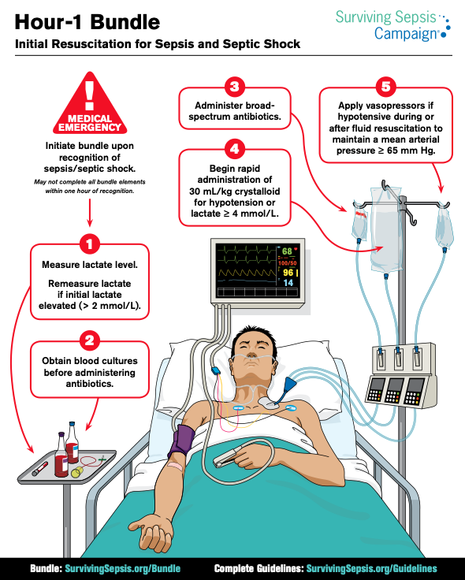

Slide 7
Surviving Sepsis Campaign 2021
Antibiotic timing: within 1 hour of recognition of sepsis and within 3 hours if concern for sepsis persists
Norepinephrine is 1st line vasopressor with MAP goal >65
Empiric MRSA, dual gram negative, and antifungal coverage should only be used based on individual patient's level of risk (low or high)
Daily assessment for de-escalation of antimicrobials over fixed durations of therapy
Balanced crystalloids > normal saline
Suggest against using vitamin C
For pts with septic shock and severe metabolic acidemia (pH ≤ 7.2) and AKI (AKIN 2 or 3), sodium bicarbonate therapy is suggested.
Early (within 72h) initiation of enteral nutrition
Address goals of care early (within 72h)

Slide 8
Local Antibiogram

Slide 9
Orlando Campus Antiobiogram 2023

Slide 10
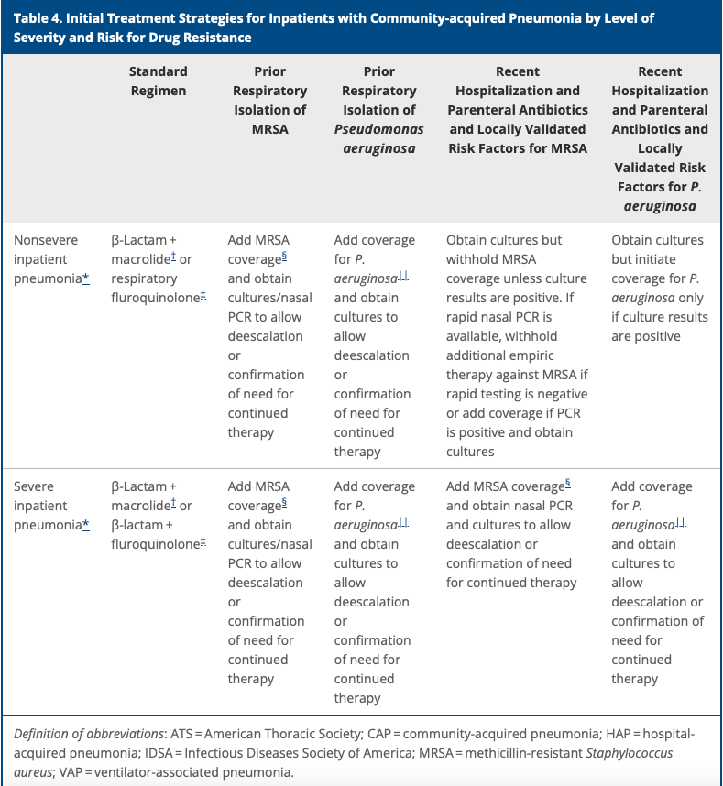
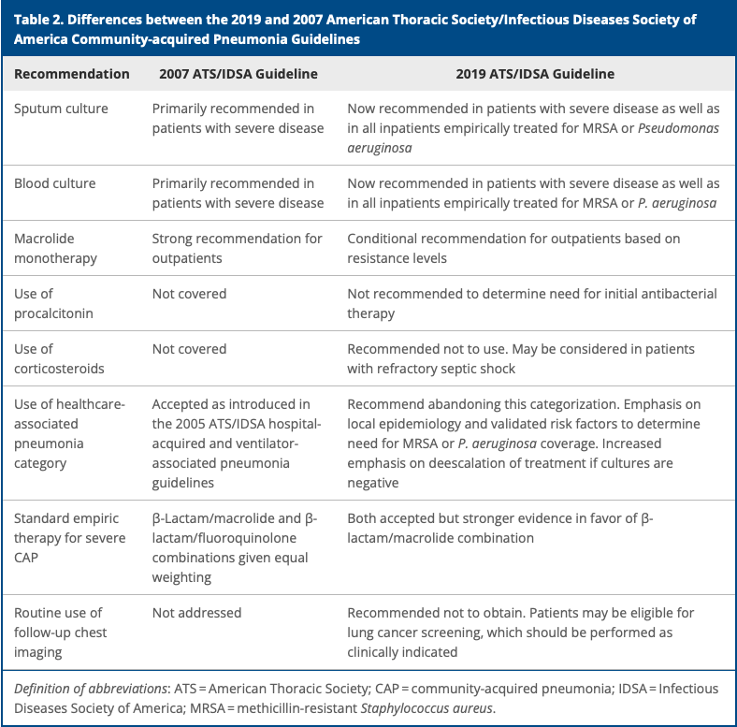
Septic Shock and CAP
Notes:
Suggest not using corticosteroids in influenza pneumonia or in pts with CAP (pending new hydrocortisone in pneumonia study)

Slide 11
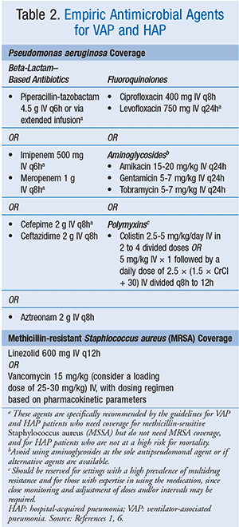
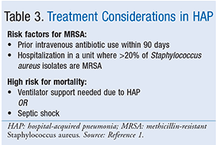
Acinetobacter species:
Carbapenems, ampicillin/sulbactam, and colistin are equally effective.
Recommend against use of tigecycline
Duration of therapy:
Daily assessment
7-day course (even with P. aeruginosa or Acinetobacter spp.)

Slide 12
Intra-abdominal Sepsis
Bacteriology consists of aerobes and anaerobes
Largest aerobe isolates included E. coli, Pseudomonas aeruginosa, and Enterococcus
Largest anaerobic isolates include Bacteroides, Clostridium, and Peptostreptococcus

Slide 13
Empiric abx for low vs high risk intra-abdominal infections
Low risk = mild to moderate severity (including perforated appendix or appendiceal abscess)
Severe or pts with recent travel to areas of the world with high rates of abx-resistant organisms, known colonization, advanced age, immunocompromised, or other major medical comorbidities

Slide 14
Intra-abdominal Sepsis
If the patient is at risk for infection with an extended-spectrum beta-lactamase (ESBL)-producing organism, a carbapenem should be chosen.
Prolonged infusions of beta-lactams should be used
If beta-lactam or carbapenem allergy --> vancomycin + aztreonam + metronidazole

Slide 15
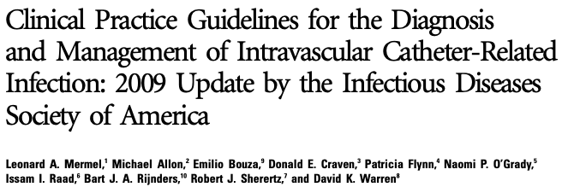
Empiric therapy: vancomycin (daptomycin if MIC >2)
Currently linezolid not recommended for use empirically
Empiric gram-negative based on local susceptibility
Pseudomonas coverage in neutropenic pts, severely ill, or colonized
CRBSI related to femoral CVC should include GNB and Candida coverage
Notes:
Linezolid is reliably utilized for MRSA meningitis, SSTI, and pneumonia, but its usage in bacteremia has been associated with higher mortality when compared to vancomycin or daptomycin

Slide 16
Empiric antimicrobials for complicated UTI

Slide 17
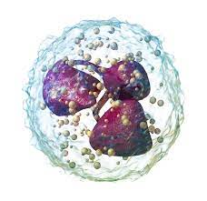
Febrile Neutropenia – Hemodynamically Unstable Patients
Discontinue levofloxacin prophylaxis
Continue viral and fungal coverage
Treatment
Cefepime
OR
Aztreonam
PLUS
Vancomycin
PLUS
Tobramycin
ADD Metronidazole if at risk for anaerobic organisms (abdominal pain, typhlitis, mucositis)
Duration of therapy depends on clinical scenario

Slide 18
Septic Shock and SSTI
For non-purulent SSTI in the ICU or evidence of penetrating trauma, MRSA nasal colonization, IVDU, or neutropenia, use the following 2 options for empiric therapy:
Option 1 | Option 2
Vancomycin + Zosyn | Vancomycin + Cefepime
Consider high dose Clindamycin if necrotizing infection for toxic suppression | Consider Flagyl if anaerobic coverage needed (diabetic foot infection, gas gangrene, ischemia) AND/OR High dose Clindamycin

