Slide 1
Hypotension and Shock: Pressors/Inotropes
ICU CURRICULUM

Slide 2
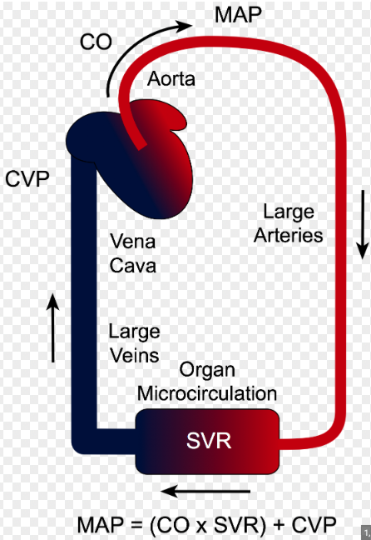
Shock
Shock occurs when supply (DO2 = oxygen delivery) does not meet demands (CO). It is NOT defined by blood pressure.
MAP is the main determinant of perfusion pressure
Goal > 65 in most patients
Another markers of tissue perfusion include mental status, UOP, and skin findings (temperature, diaphoresis, mottling, capillary refill)
Lactic acidosis doesn't always mean a patient is in shock
MAP = CO X SVR
HR
SV
Preload
Contractility
Afterload

Slide 3
Evaluation of Hypotension
History and Physical Exam
Adequate IV access
Continuous cardiac and pulse ox monitoring
CXR
CBC, CMP, lactate, ABG, BGL
Cortisol
TSH
Coags
Procalcitonin
Troponin
Bedside US!! (RUSH exam)

Slide 4
Categories of Shock
Hypovolemic
Fluid loss
Hemorrhage
Burns
Distributive
Sepsis
Anaphylaxis
Drug ingestions
Cardiogenic
Obstructive
Tamponade
Pulmonary Embolism
Pneumothorax
Acute MI/Post cardiotomy
Myocarditis
Arrhythmias

Slide 5
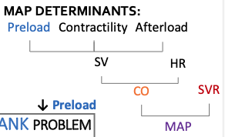
Determinants of MAP
When you think about shock, remember the determinants of MAP.
The primary problem is accompanied by some form of compensation to maintain perfusion to vital organs
For example, in cardiogenic shock, the primary problem is the PUMP, so cardiac output (CO) is low
When CO is low, SVR must increase to maintain the MAP.

Slide 6
Undifferentiated Shock
CO
Preload
TANK Problem
PUMP Problem
SVR
PIPES Problem
CARDIOGENIC
OBSTRUCTIVE
DISTRIBUTIVE
HYPOVOLEMIC
CO
CO
Var CO
CO
SVR
SVR
SVR
SVR
CVP
CVP
Var CVP
CVP
PCWP
PCWP
Var PCWP
PCWP

Slide 7
Pump Problem – Low CO

Slide 8
Pipes Problem – Low SVR

Slide 9
Tank Problem – Low Preload

Slide 10
Approach to Management of Shock

Slide 11
Vasopressors and Inotropes

Slide 12
Vasopressors
α1, β1, β2
+
DA
Drugs with both vasopressor and inotropic effects (inopressors)
Norepinephrine (Levo) - 1st line vasopressor for septic shock
Epinephrine (adrenaline) - idea for anaphylactic shock, increases lactic acid production
Dopamine – no longer considered a first line vasopressor; more arrhythmogenic than norepi
Vasopressin – used at fixed dose (higher in GI bleeds); good adjunct for septic shock
Does not increase PA pressures like other pressures, but higher risk of gut ischemia
Phenylephrine (Neo) - good for pure vasodilatory states in patients who can't tolerate inotropy
Angiotensin II (Giapreza) - used in septic/distributive shock, expensive, high incidence of arterial and venous thromboembolism (12.9% in ATHOS-3 trial)
V1, V2
α1
AT1, AT2
Pure vasopressors with no effects on cardiac contractility

Slide 13
Vasopressor Refractory Shock
Make sure you are treating the right type of shock. If not, re-evaluate.
Acidosis decreases the efficacy of pressors (vasopressin is the only pH independent vasopressor)
Use stress dose steroids for septic shock or in patients with suspected adrenal insufficiency
Hydrocortisone 50mg every 6 hours
Alternative agents:
Methylene blue
Nitric oxide scavenger
Dose 1-2 mg/kg SLOW IV push
Good for refractory hypotension or hypotension due to vasoplegia (ie, after cardiopulmonary bypass)
VA ECMO
More data to support severe septic shock as indication for ECMO in children

Slide 14
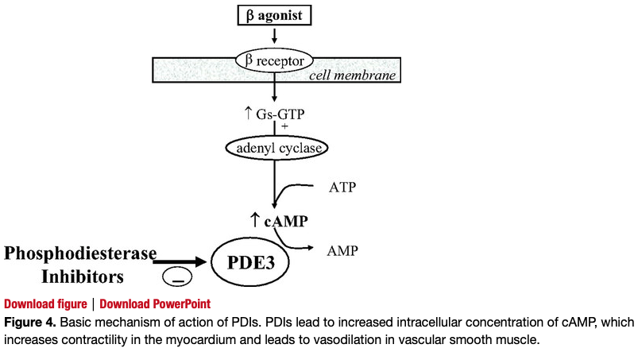
Inotropes
Dobutamine – preferred inotrope for acutely unstable patients in cardiogenic shock (short t ½ < 2mins); prolonged use can lead to tachyphylaxis; high doses cause vasodilaton due to its B2 agonist effects
Milrinone – good for pts with pulmonary hypertension (lowers SVR and PVR), side effect of hypotension, longer t ½ (2-4 hours)
α1, β1, β2
Milrinone

Slide 16
Patient Monitoring with Vasopressor and Inotropic Support
Invasive blood pressure monitoring (arterial line)
Pulmonary artery catheter (Swan-Ganz)
Vasopressor use is safe and effective with peripheral administration if:
The PIV is newly placed in a larger vein (4mm or larger) and not in the hand, wrist, or antecubital fossa
You have a protocol to monitor for and treat extravasation
Peripheral administration should generally be limited to less than 24 hours

Slide 17
Push-dose Pressors

