Slide 1
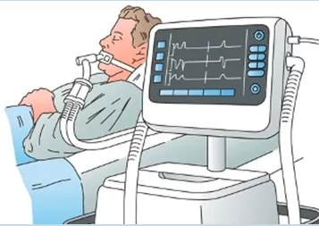
ICU CURRICULUM
Ventilator Basics:
Choosing the Right Mode

Slide 2
Goals for Mechanical Ventilation
Oxygenation – maintain PaO2/SpO2
Ventilation – maintain pH
Patient comfort – vent synchrony, decrease sedation
Facilitate weaning – minimize muscle loss, promote readiness to wean from support (42% of mechanical ventilation time is spent weaning the ventilator)
*Another use of MV support is airway protection

Slide 3
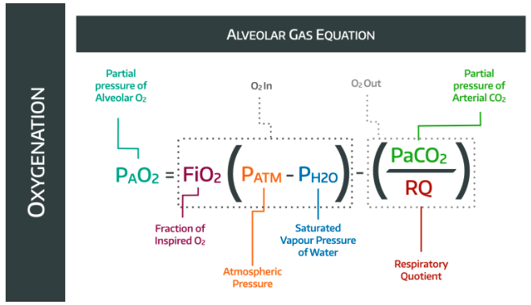
Oxygenation
Works by simple diffusion
How to adjust on the vent:
FiO2
PEEP
Inspiratory time (I:E ratio)
Mean airway pressure
PaO2 = 0.21 (760 mmHg – 47 mmHg) - PaCO2/ 0.8

Slide 4
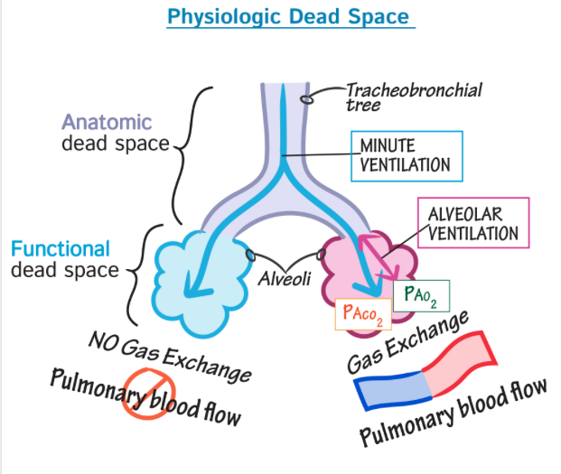
Ventilation
Works by convection
How to adjust on the vent:
Respiratory rate (RR)
Tidal volume (Vt)
Expiratory time
Minute Ventilation = RR x Vt

Slide 5
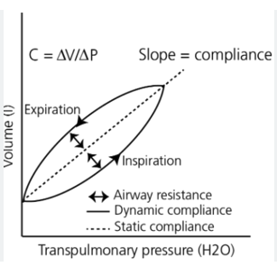
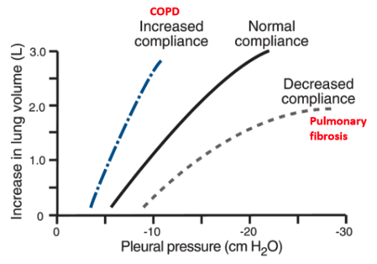
Compliance
A function of the airways, lungs, and the ventilator system itself
Compliance = Volume / Pressure
Initially consider compliance to be fixed.
However, we can increase or decrease compliance when we diurese, modulate inflammation (steroids/abx), optimize vent settings to improve comfort, or even paralyze patients to improve compliance.

Slide 6
MV is a TOOL not a SOLUTION
MV provides support to a patient. It does not "fix" them.
The overall clinical goal is maintain appropriate levels of O2 and CO2 content, while unloading ventilatory muscles.
An equally important goal is provide support without harming the lungs

Slide 7
Choosing the right vent mode
The first step involves identifying the patient's indication for needing MV support.
Am I supporting the patient's oxygenation, ventilation, work of breathing (comfort), or both?
Vent modes fall into 2 broad categories:
Pressure
Volume
Each mode has 3 features:
Trigger – what initiates a breath?
Cycle – what ends a breath?
Limit – what stops a breath early?

Slide 8
Basic Vent Settings
Volume control (VC):
You set the tidal volume that the vent will deliver every breath
The dependent variables are pressure and flow.
Good general-purpose mode
Ensures a minimum MV is achieved.
Good mode for lung protective ventilation (in ARDS, for ex)
Settings:
Volume/RR/PEEP/FiO2 (this is how you will report them on daily rounds)
Pressure control (PC):
You set the inspiratory pressure (IP) for a set time (I time) for every breath
The dependent variables are volume and flow.
The difference in IPAP-EPAP determines your volume (EPAP is PEEP!), as well compliance! (C=V/P)
Good for limiting pressure
Also can be used for LPV (no difference in mortality)
Settings:
IPAP/PEEP/RR/FiO2
Notice that there is only one variable that distinguishes VC from PC!!

Slide 9
Pressure Support Ventilation (PSV)
Don't confuse Pressure Control ventilation (PCV) with Pressure Support ventilation (PSV)
Pressure support is a weaning mode.
Unlike VC and PC, which are assist control modes, pressure support depends on the patient initiating their own breaths.
PSV provides a small amount of pressure during inspiration to help the patient draw a spontaneous breath
This is the mode we use for SBT.
What do you set?
FiO2
PEEP
Pressure support above the PEEP after the patient initiates a breath
This mode does not guarantee a rate.
On rounds:
"The patient is on PS 10 over 5, 40%"
10 over 5 = PS 10 + PEEP 5 = PIP 15cm H20

Slide 10
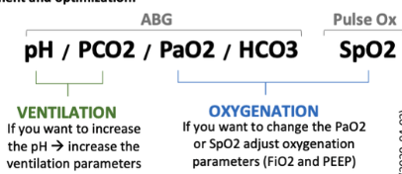
Now that we understand the basics...
How do we fix hypoxia on the vent?
Remember the variables that affect oxygenation?
How do we fix hypercapnia?
What variables affect ventilation?
We can increase mean airway pressure by:
Increasing PEEP (and IP if in PC mode)
Adjust the inspiratory time (more time in inspiration where the IP is higher)
Increase minute ventilation:
Increase tidal volume (Vt)
Or increase RR

Slide 11
Now you're a pro! Go look at some vents...but no touchy

