Slide 1
Arrhythmias and Hypertensive Crises
ICU CURRICULUM

Slide 2
Arrhythmias in the ICU
Incidence of sustained arrhythmias approach 40%
Risk factors in the critically ill:
Advanced age, sepsis, myocardial ischemia, respiratory failure, renal insufficiency, acute brain injury, polypharmacy, metabolic disturbances, cancer, trauma, and burns
Tachyarrhythmias (HR > 100 bpm)
Bradyarrhythmias (HR < 60 bpm)

Slide 3
Tachyarrhythmias
Narrow QRS complex (≤ 120 ms)
Supraventricular tachycardias (SVTs) - involving tissue from the His bundle or above
Sinus tachycardia
AVNRT
Atrial fibrillation
Atrial flutter
Wide complex (QRS > 120 ms)
Ventricular tachycardias (VTs)
SVTs with abnormal conduction patterns

Slide 4
Causes of sinus tachycardia:
Non-pharmacological
Pain
Anxiety
Hypvolemia
Hypoxia, hypercarbia
Acidemia
Sepsis, pyrexia
Anemia
PE
Cardiac tamponade
Hyperthyroidism
Alcohol withdrawal
Pharmacological
B-agonists: epinephrine, isoproterenol, dobutamine
Sympathomimetics: amphetamines, cocaine, methylphenidate
Antimuscarinics: antihistamines, TCAs, carbamazepine, atropine
Others: caffeine, theophylline, marijuana
Usually a secondary condition
Tip: with very fast HRs, the P waves may be hidden in the preceding T wave, producing a 'camel hump' appearance

Slide 5
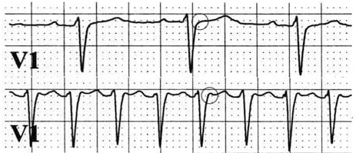
AVNRT
Pseudo-R wave seen during tachycardia (bottom strip) but not seen in sinus rhythm (top strip)
AVNRT is the most type of 'classical' SVTs
The commonest cause of palpitations in patients with structurally normal hearts
Reentry circuit either within or near the AV node
Regular narrow complex tachycardia with indiscernible or retrograde P waves (as pseudo r' or S waves)
2:1 female to male risk
Stable:
Vagal maneuvers (Valsalva, carotid massage) in supine position
IV adenosis
Refractory -> IV diltiazem, verapamil, or B-blockers
Unstable: DDCV

Slide 6
Atrial fibrillation
Most common sustained arrhythmia, with a lifetime risk of 25%
AF with 'rapid ventricular response' is > 100 bpm
Accelerated ventricular rates and loss of "atrial kick" during AF may lead to rapid hemodynamic deterioration
Hemodynamically stable: rate control, rhythm control/cardioversion, anticoagulation
BB, nondihydropyridine CCBs, digoxin
CCBs are contraindicated in acute heart failure
Digoxin in patients with AF have been associated with sudden cardiac death
Amiodarone is an effective rhythm control agent that doesn't dramatically lower the BP
Hemodynamically unstable patients should undergo synchronized DCCV
CHADS2VASC

Slide 7
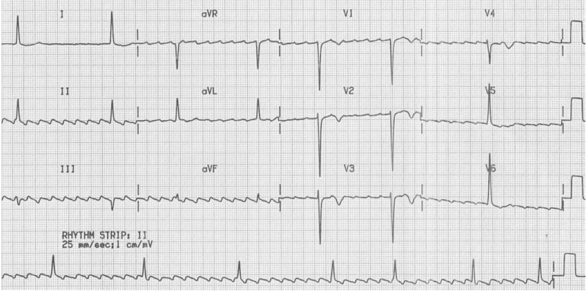
Atrial flutter
Regular atrial activity at ~300 bpm
Ventricular rate depends on AV conduction ratio
Fixed AV block:
2:1 block = 150 bpm (most common)
3:1 block = 100 bpm
4: 1 block 75 bpm
Variable AV block
Ventricular response is irregular and may mimic Afib
Acute management and risk of thromboembolism similar to Afib
Aflutter with high-grade AV block (varying from 5:1 up to 8:1)
Note: The combination of new-onset atrial flutter with high-grade AV block is very suspicious for digoxin toxicity.

Slide 8
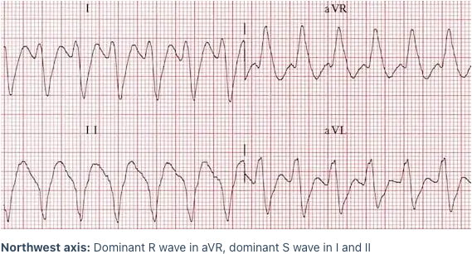
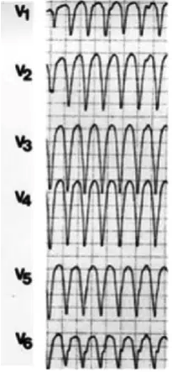
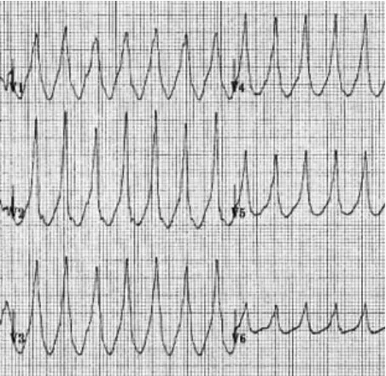
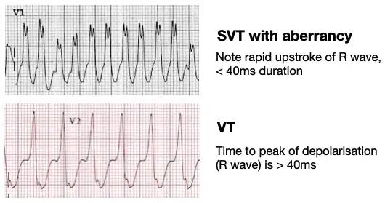
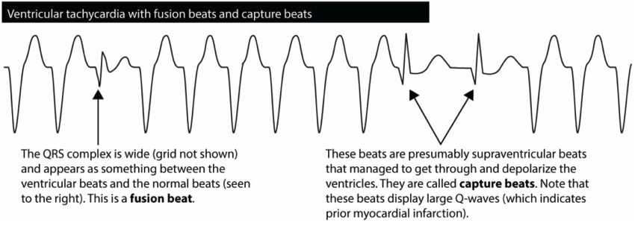
Ventricular Tachycardia
70% of regular WCT is VT
History of MI, structural heart disease, and/or old age makes VT even more likely
ABCDE approach to distinguish VT from SVT:
A – Axis | Northwest axis (-90 to –180 degrees (90% specific for VT) Dominant R wave in aVR
B – Broad complexes | >200 ms (85-90% specificity for VT)
C – Concordance | Precordial concordance (positive = entirely positive complexes in lead V1-6 or negative = entirely negative QS complexes in V1-6)
D – Dissociation | Any evidence of AV dissociation is highly specific for VT (P and QRS complexes at different rates Capture and fusion beats
E – Early part of QRS | VT and SVT with aberrancy differ in the way they engage the His-Purkinje network VT – R wave > 40 ms; SVT w/ aberrancy – Rapid upstroke of R wave (< 40ms)
Positive concordance
Negative concordance

Slide 9
ACLS
Cardioversion Rules:
QRS narrow and regular: 50-100 J (aflutter)
QRS narrow and irregular: 120-200 J (afib)
QRS wide and regular: 100 J (~70% VT)
QRS wide and irregular: Defibrillate

Slide 10
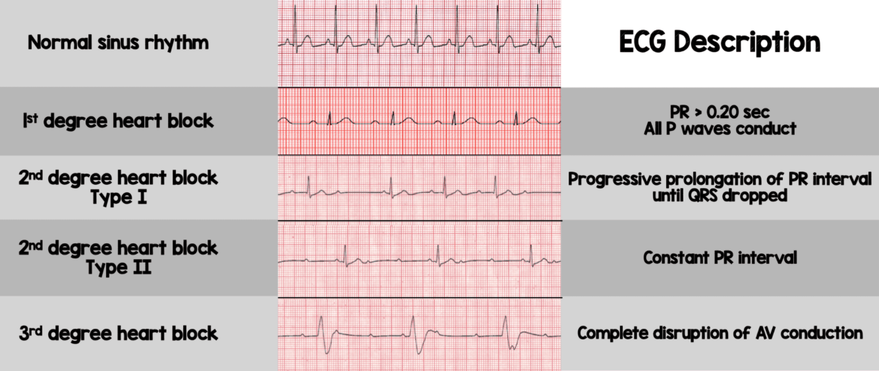
Bradyarrhythmias
More common in older patients because of age-related degeneration and fibrosis of the conduction system
Sinus node dysfunction (SND) - can manifest as sinus bradycardia, sinus pauses, or tachy-brady syndrome
Correct reversible causes
Chronotropy (atropine, dopamine, isoproterenol, epinephrine)
Pacing
AV nodal disease (variable heart block)
PPM indicated for 2nd degree type II, high grade AV block or 3rd degree AV block
Check TTE to eval for presence of structural heart disease

Slide 11
ACLS

Slide 12
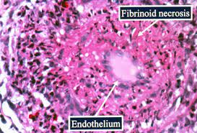
Hypertensive Crises
Hypertensive emergency = elevated BP associated with evidence of acute end-organ damage
Generally DBP > 120mm Hg
Hypertensive urgency = SBP > 180 and DBP >115 without evidence of acute end-organ damage
Disruption of vascular integrity -> fibrinoid necrosis of the arterioles and myointimal proliferation seen in multiple organs (histologic hallmark of hypertensive emergency)

Slide 13
Malignant Hypertension
Malignant hypertension is a specific syndrome = markedly elevated BP associated with neuroretinopathy
Risk Factors:
Age between 30 – 50
Male gender
Black background
Smoking
Increases the risk by 2.5-5-fold

Slide 14
Hypertensive Encephalopathy
Distinctive clinical syndrome when rapidly riding cerebral perfusion pressure (CPP) exceeds the ability of the CNS to autoregulate
Autoregulation of cerebral blood flow (CBF)
CBF = CPP / CVR, where CVR is cerebral vascular resistance
Inability to regulate CBF is seen when the MAP > 140 mm Hg
PRES [posterior reversible encephalopathy syndrome]: edema seen posteriorly, particulary in the parieto-occipital regions. If suspected, MRI brain should be obtained.

Slide 15
Clinical Presentation
Headache (occipitally or anteriorly, steady quality)
Visual complaints (scotoma, diplopia, hemianopsia, blindness)
Neurologic symptoms (focal deficits, stroke, TIA, seizures, confusion, somnolence)
Ischemic chest pain
Renal symptoms (nocturia, polyuria, hematuria)
Back pain (aortic aneurysm)
Nausea, vomiting
Often intravascular volume depletion (high levels of circulating renin and angiotensin induce a diuresis)

Slide 16
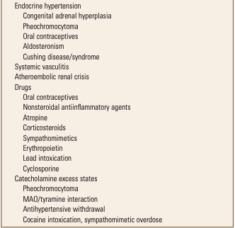
Syndromes of Hypertensive Crisis

Slide 17
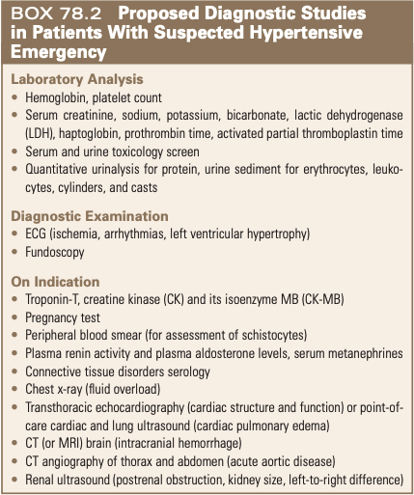
Diagnosis
Physical Exam:
Dilated funduscopic exam
Papilledema on ocular US
CV exam (signs of CHF, JVD, displaced PMI, S4 gallop)
Peripheral pulse exam (absence or delay suggestive of aortic dissection)
Peripheral edema
Abdominal bruit, enlarged kidneys
Complete neuro exam (TIA, CVA, hypertensive encephalopathy)

Slide 18
Treatment – General Approach
Reduce BP acutely by 20-25% within minutes to 1 hour
BP is further reduced to 160/110 over the next 2-6 hours
Goal 140/90 over following 24-48 hours

Slide 19
Treatment – Special Considerations
Malignant hypertension | Nitroprusside previously preferred agent – monitor thiocyanate levels Alternatives: Fenoldopam and Nicardipine 50% of pts who require RRT will regain renal recovery
Hypertensive Encephalopathy (incl PRES) | Reduce MAP cautiously by no more than 15% over 2-3 hours AMS improves within 12-24h
Ischemic Stroke | Reduce BP < 185/110 prior to giving tPA Permissive HTN unless > 220/120 After mechanical thrombectomy, keep SBP 140-160
SAH | Reduce 20-25% over 6-12h, but not < 160/100 (vasospasm) Labetalol and Nicardipine are preferred agents Nimodipine decreases vasospasm and associated delayed cerebral ischemia
ICH | Unlike ischemic CVA, where BP gradually returns to normal within 24-48h, the most rapid decline in BP occurs in the first 24h, but it may remain elevated for 7-10 days No clear consensus, but an SBP goal 140-180 is reasonable
Head trauma | Maintain CPP > 70 and MAP >90 using ICP monitoring Combination alpha- and beta-blocker or Nicardipine if inc ICP. If no ICH, vasodilators preferred.
Aortic dissection | Type A – surgery, type B – medical mgmt Target HR <60 and SBP 100-120; Esmolol, Labetalol. Vasodilators: Nitroprusside, Nicardipine, Nitroglycerin, Fenoldopam
Pulmonary edema | Vasodilators to improve diastolic relaxation and lower pulm venous pressure BB may also be used
Perioperative hypertension | Lower BP <180/110 before noncardiac surgery Continue home BB or clonidine to prevent rebound hypertension
Catecholamine-associated hypertension | IV phentolamine followed by B-blockade Labetalol has been used for pheochromocytoma
Gestation hypertension, Preeclampsia, and Eclampsia | Keep BP <160/110 - IV Labetalol and NIcardipine, PO Nifedipine Hydralazine no longer recommended. Nitroprusside and ACEI should be avoided (cyanide toxicity in the fetus, fetal kidney impact, respectively)

