Slide 1
ICU CURRICULUM
Cardiogenic Shock
and
Mechanical Circulatory Support

Slide 2
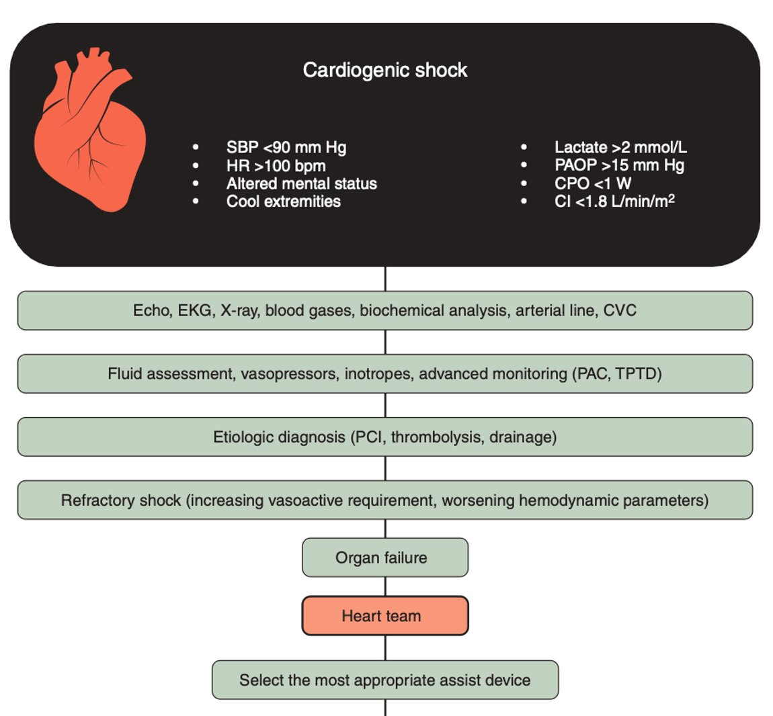
Definition of Cardiogenic Shock
Cardiac dysfunction with an inability of the LV to maintain an adequate cardiac output (CI <2.2) despite normal to elevated pre-load
PCWP >15
SBP < 90 mmHg for >30 min or catecholamines required
Impaired organ perfusion:
AMS
UOP <30 mL/h
Cold/clammy extremities
Lactic acid > 2

Slide 3
Cardiogenic Shock
Cardiogenic shock is most commonly caused by AMI (AMI-CS) or acute decompensated HF (HF-CS).
There are different classifications of CS based on the cause (Killip class, NYHA, INTERMACS)

Slide 4
Heart Failure Severity after Acute MI

Slide 5
Defining Advanced Heart Failure

Slide 7
The Benefits of Mechanical Support
Vital organ perfusion in a shock state
Reduce intracardiac filling pressures reducing congestion
Reduce LV wall stress, LV volumes, myocardial O2 consumption
Augment coronary perfusion
Support circulation during high risk procedures and/or EP procedures
Limit infarct size

Slide 8
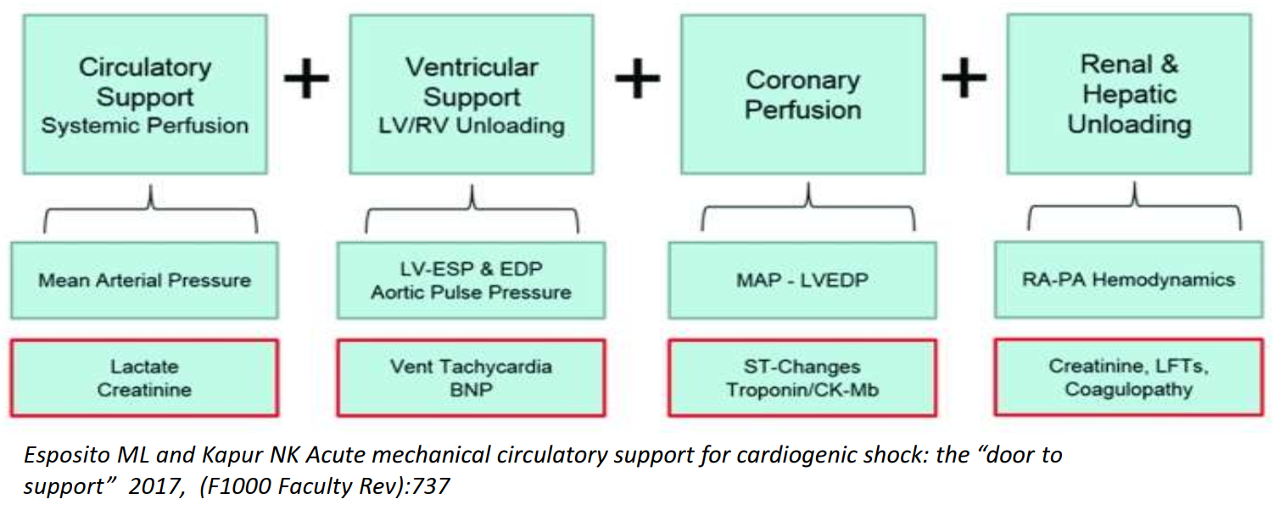
Mechanisms

Slide 9
When is Mechanical Support Used?
Acute MI and all the complications of it
Cardiogenic shock, acute MR, VSD
Severe Heart Failure in Non-Ischemic Cardiomyopathy
Cardiac graft failure, post-transplant RV failure, slow to wean from Bypass
Refractory Arrythmias
High-Risk PCI
Complex VT ablation
High-risk valve surgeries

Slide 10
The Types - Simple
Intra-Aortic Balloon Pump (IABP)
Impella
ECMO
TandemHeart
Total Artificial Heart (TAH), Jarvik
Centrimag - temporary
Heartmate - durable

Slide 11
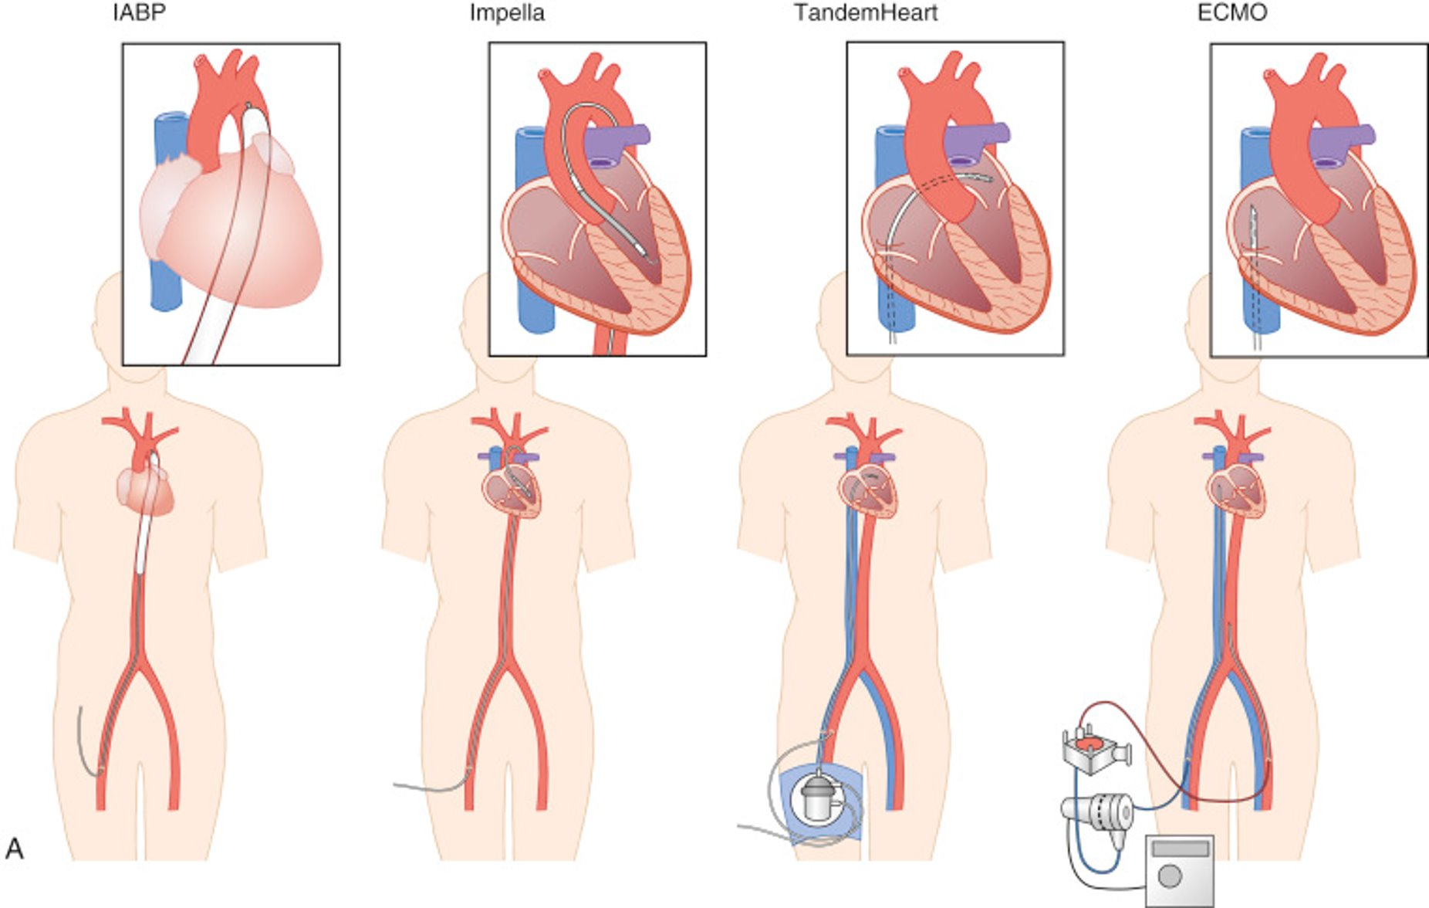

Slide 12
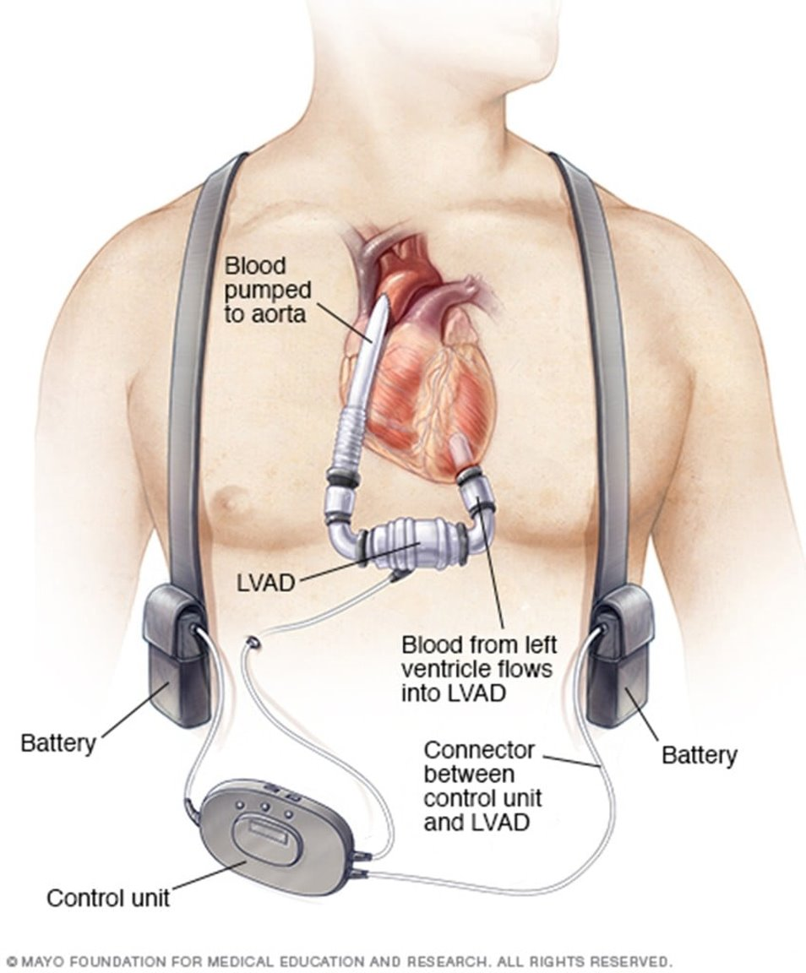
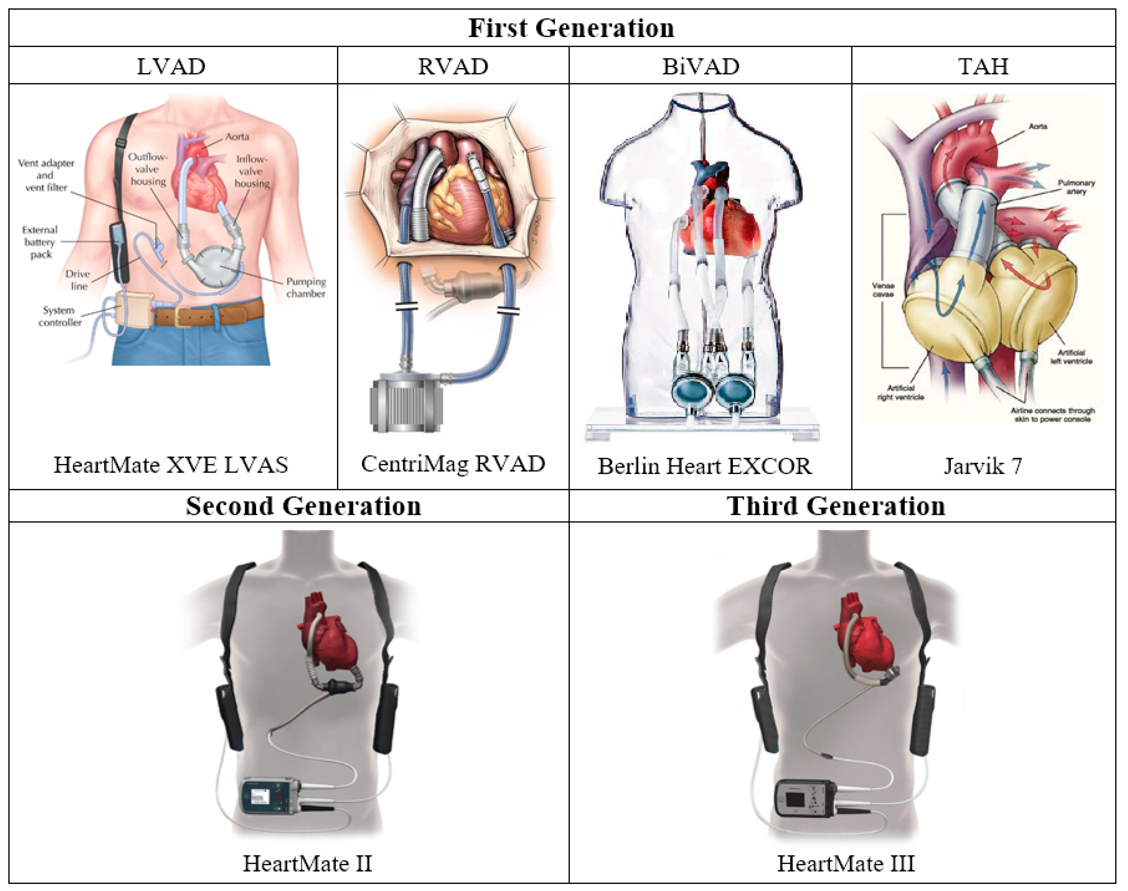
Content

Slide 13
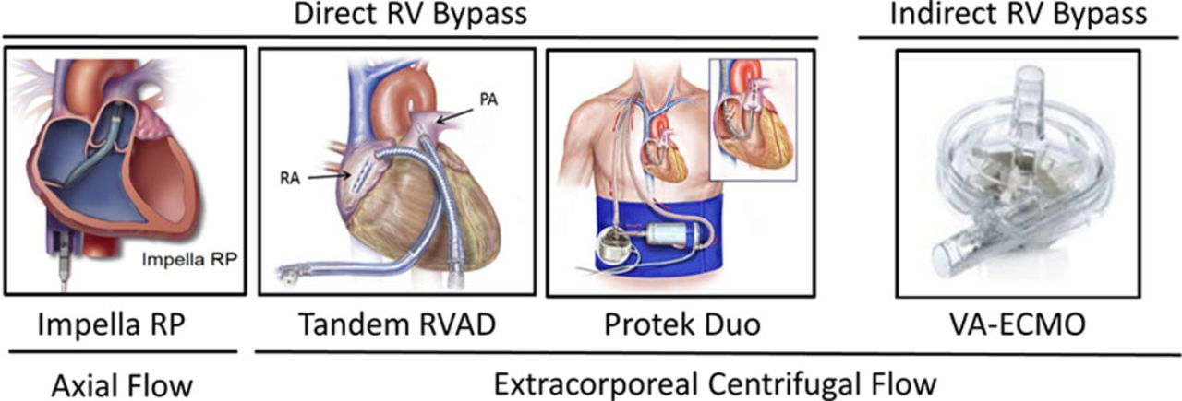
RV Support (not discussed)
Content
Content

Slide 14
Intra-aortic balloon pump (IABP)
The most commonly used
2 parts: Balloon and control
7.5 Fr – 8Fr (Slightly bigger than a triple lumen CVC, 7Fr)
Filled with helium – low weight, easy to pump in and out. Absorbs into blood quickly in case of rupture
Principle of counterpulsation:
Balloon goes up in diastole. Balloon goes down in systole
Up in T-wave, Down in R wave

Slide 15
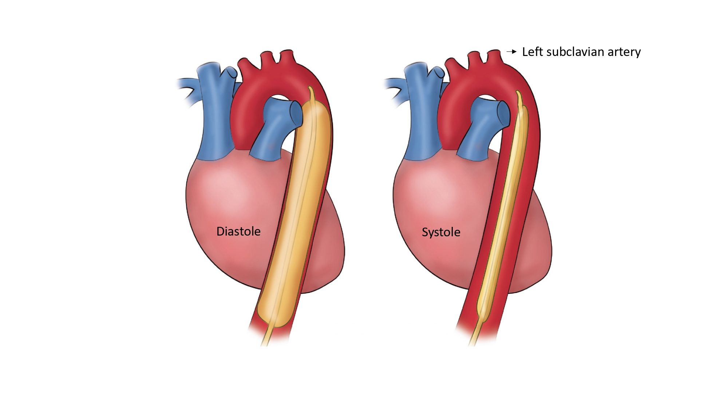
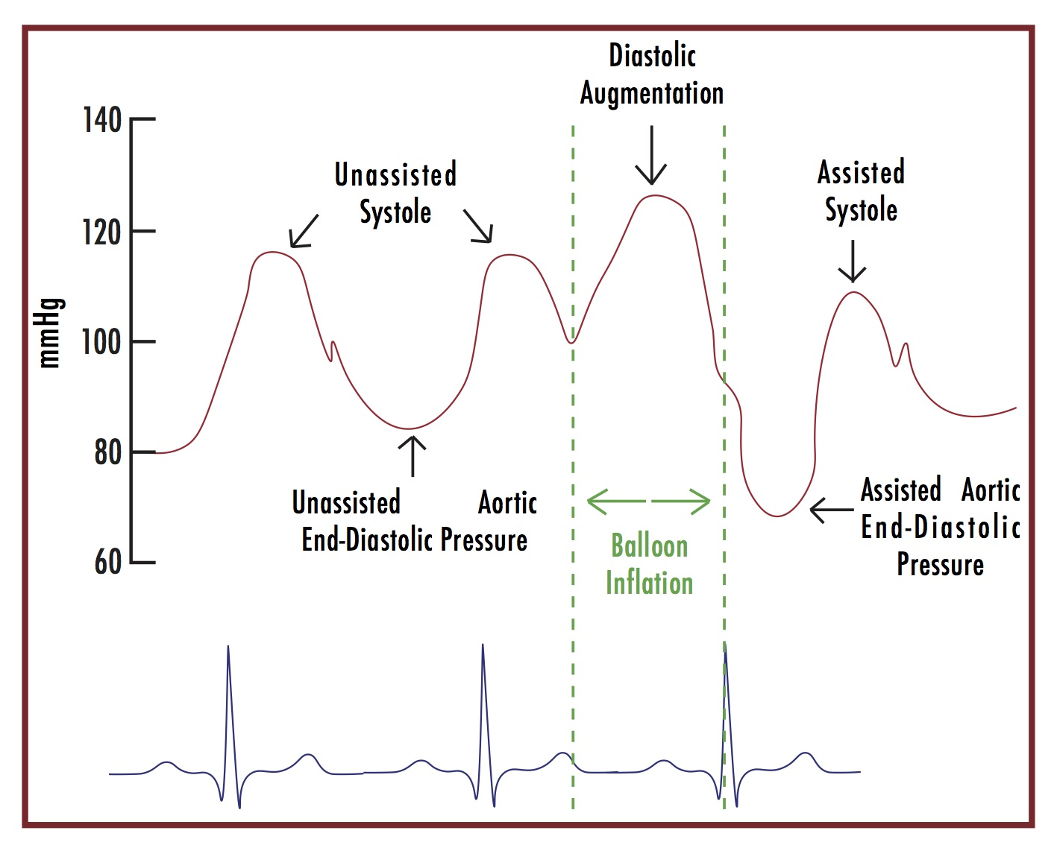
Counterpulsation of IABP – The Good
Balloon inflates in diastole
Augmentation of diastolic pressure
Increases coronary perfusion
Balloon deflates in systole
Decreases afterload, myocardial consumption
Increases CO (0.5-1L)

Slide 16
The Bad
Contraindications
Aortic Regurgitation
Severe PAD
Aortic Dissection
Complications
Thrombocytopenia
Immobility
Vascular issues/Stroke/Bowel Ischemia/AKI
Balloon Rupture

Slide 17
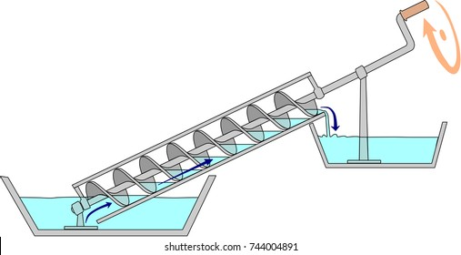
The Impella
Microaxial motor – Archimedes Screw Pump
2.5 (12F), CP (14F), 5.0/5.5 (21F)
Pigtail on one side
Protects the positioning
Purge solution
D20, D10?, D5, Heparin, Bicarbonate

Slide 18
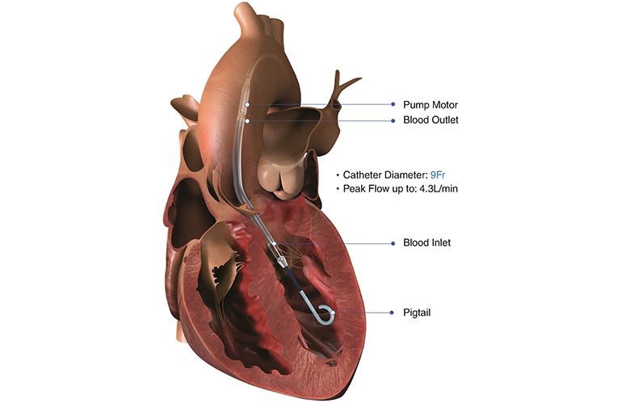
The Impella
Unloads LV, non-pulsatile flow into the aorta
CO: 2 to potentially 5.5L (CP maxing around 4L/min)
Reduces wall stress and unloads more than IABP
The Good
Contraindications:
Mechanical aortic valve
LV thrombus
Aortic regurgitation
Severe AS* (relative unless valve can be crossed with wire)
Aortic dissection
Complications:
Bleeding
Hemolysis
Thrombosis
Limb ischemia
The Bad

Slide 19
MCS Devices and Cardiac Flow

Slide 20
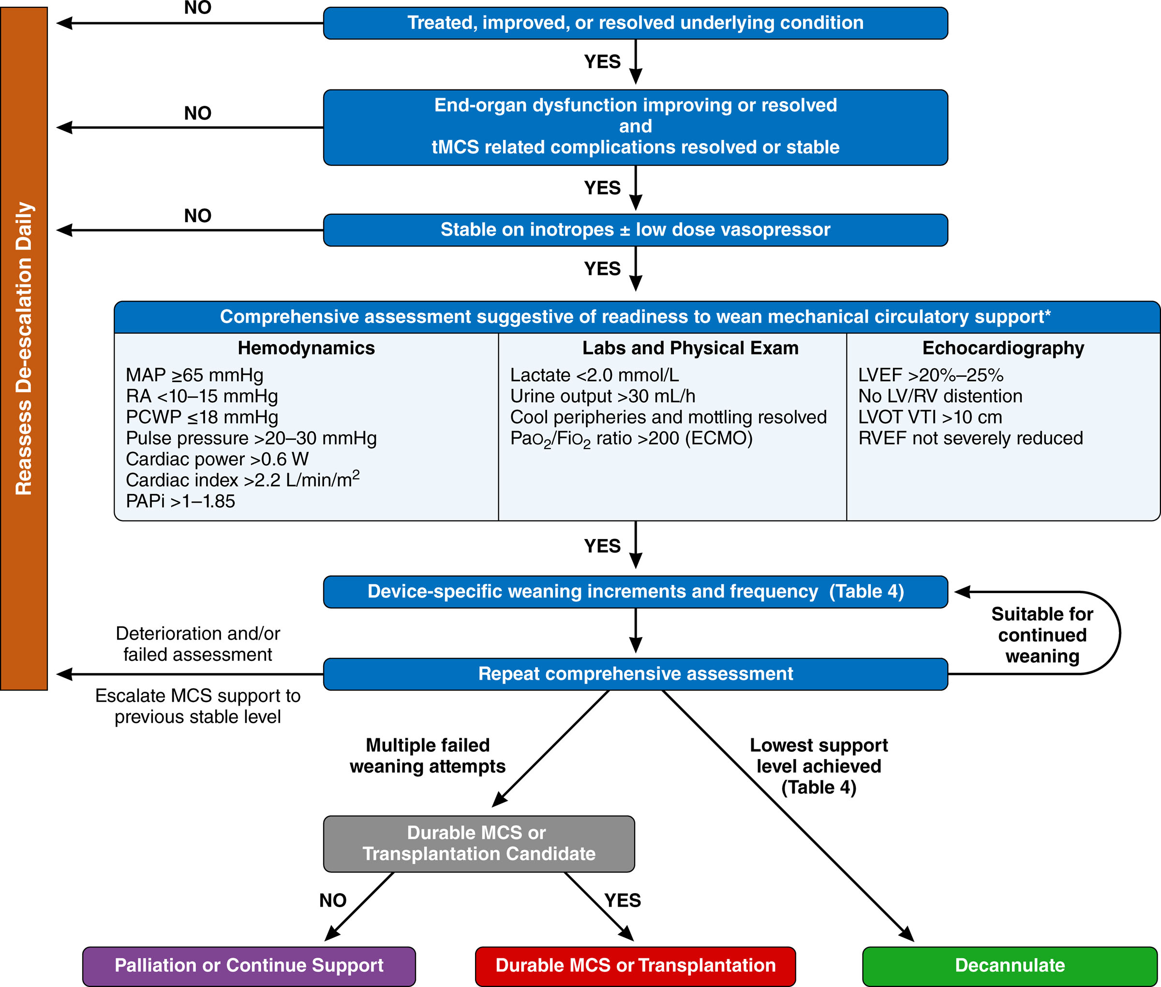
Mechanical Support is a bridge to somewhere...
Content
Notes:
https://www.ahajournals.org/doi/10.1161/CIR.0000000000001076

Slide 21
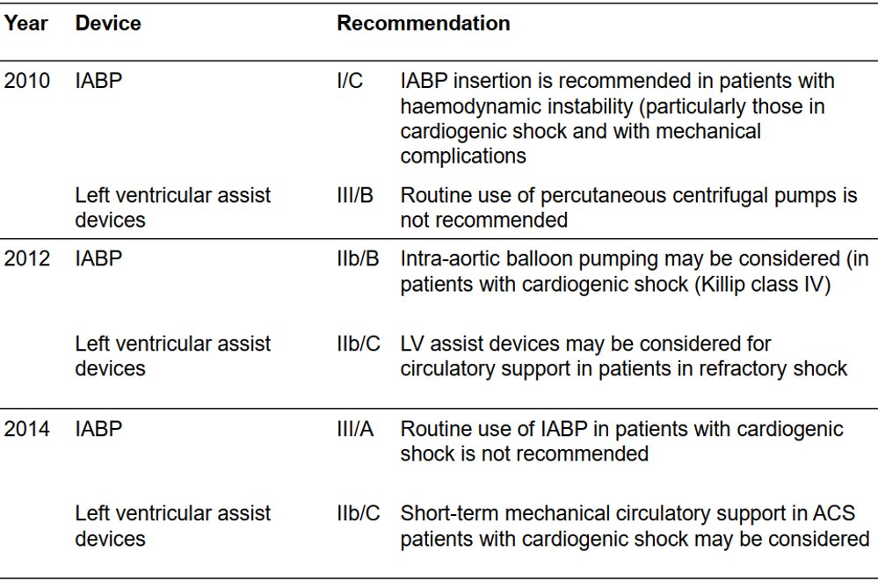
Guidelines
ACC/AHA
ESC

Slide 22
Timing: Door to Unload

