Slide 1
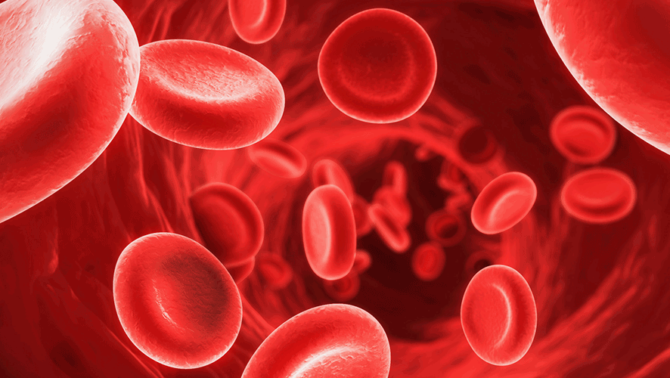
ICU CURRICULUM
Overview of Acute GI Bleed

Slide 2
Clinical Case
45 year old lady with a history of alcoholic cirrhosis presents to the ER with hematemesis and BRBPR.
HR 145 BP 76/42 RR 28 SpO2: 100% on RA Temp: 98
Gen: somnolent and difficult to arouse
HEENT: + scleral icterus
Cards: tachycardic
Lungs: clear to auscultation bilaterally
Abdomen: distended, but soft
Extremities: trace bilateral LE edema

Slide 3
Labs
7.3
128
98
42
112
18
60
4.3
16
0.7
22
Pro
6.8
T-bil 7.2
AST
255
PT 42
INR 2.23
Alk Phos 100
Alb
2.8
D-bil 6.5
ALT 180

Slide 4
Clinical Question
The patient has a witnessed episode of large volume hematemesis. What should be done next?
Intubate the patient, place a triple lumen CVC, and type and cross 4 units PRBC to be immediately transfused
Place 2 large bore peripheral IVs, start vasopressor therapy, and call GI for emergent endoscopy
Place 2 large bore peripheral IVs, intubate the patient, start IV fluid resuscitation, and cross match 4 units PRBC to be immediately transfused
Call GI for emergent endoscopy, intubated the patient, place an introducer sheath for IV access, and activate mass transfusion protocol

Slide 5
Clinical Question
The patient has a witnessed episode of large volume hematemesis. What should be done next?
Intubate the patient, place a triple lumen CVC, and type and cross 4 units PRBC to be immediately transfused
Place 2 large bore peripheral IVs, start vasopressor therapy, and call GI for emergent endoscopy
Place 2 large bore peripheral IVs, intubate the patient, start IV fluid resuscitation, and cross match 4 units PRBC to be immediately transfused
Call GI for emergent endoscopy, intubated the patient, place an introducer sheath for IV access, and activate mass transfusion protocol

Slide 6
Initial management
IV access
Two large bore peripheral IVs (14-16 gauge)
Introducer sheath/Cordis (8 F - 9.5 F)
Intubation
Type and Cross
Emergent release of O negative blood
PPI BID
Octreotide drip
NG lavage

Slide 7
Hemodynamics of Hemorrhagic Shock
Trauma literature
 | I | II | III | IV
Blood Loss [% of blood volume] | Up to 15 | 15-30 | 30-40 | >40
Heart Rate | <100 | 100-120 | 120-140 | >140
Blood Pressure | Normal | Normal | Decreased | Decreased

Slide 8
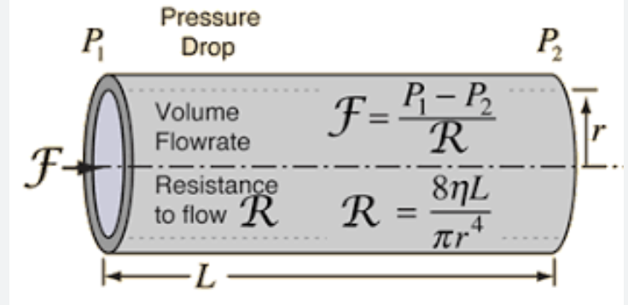
La Poiseuille's Law
Laminar flow of fluid depends on many factors, including the pressure gradient across the tubing, viscosity of the fluid, radius (r⁴), and length of the tubing.
Temp HD catheters are 13Fr and can achieve flow rates of 350-400 mL/min (ie time to infuse 1L = 3.5-4 mins

Slide 9
Resuscitation
Restrictive transfusion strategy (hgb <7) decreases mortality and morbidity relative to liberal transfusion strategies.
Massive transfusion protocol (MTP) = 4 PRBC : 4 FFP : 1 PLT
Anticoagulant reversal
Localization of bleeding
Suspected variceal hemorrhage -> Octreotide

Slide 10
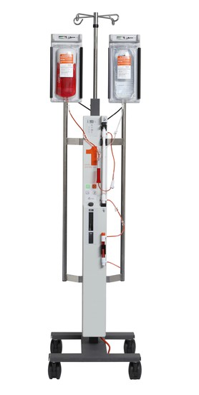
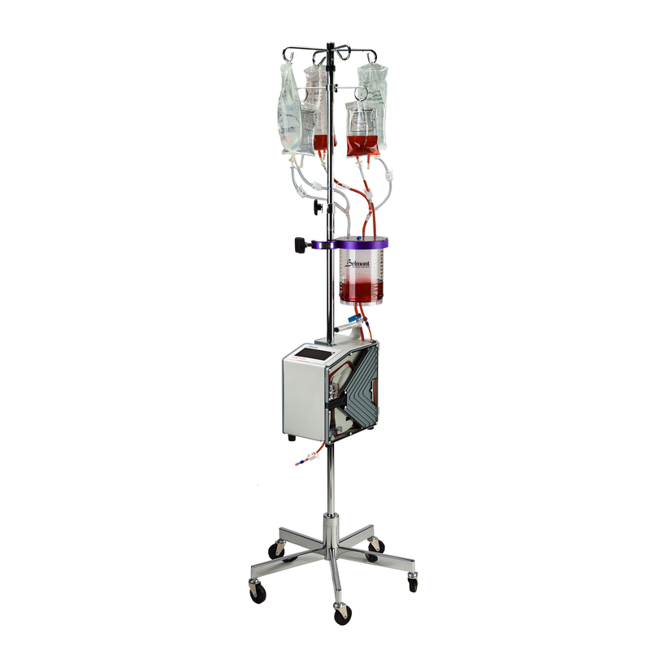
Massive transfusion protocol (MTP)

Slide 11
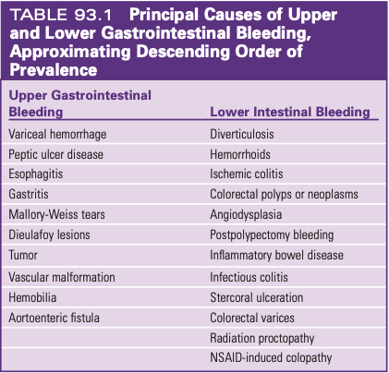
Differentiate Source
Upper GI
Proximal to ligament of Trietz
Hematemesis
Coffee ground emesis
Melena
Can also be BRBPR if rapid enough bleed
Elevated BUN:Cr (30:1)
Lower GI
Lack of UGI findings

Slide 12
Upper GI Bleed - General Approach
IV Access
Introducer sheath (8 Fr) > HD cath (13 Fr) > Large bore PIV 14G/16G > Triple lumen CVC
Acid suppression
PPI preferred over H2 blocker
JAMA Meta-analysis showed no difference in twice daily PPI vs infusion
Somatostatin (octreotide)
Causes splanchnic vasoconstriction and decreased portal inflow
Results in decrease in portal pressure so most useful in variceal/portal hypertensive diseases
Limited or no role in documented ulcer disease
Given as 50 mcg bolus then infusion of 50 mcg/hour

Slide 13
Upper GI Bleed - Special Considerations
Uremia frequently seen either from GI bleed or acute kidney injury
Causes intrinsic platelet dysfunction and abnormal platelet-endothelial interactions
Desmopression (ddAVP) can decrease dysfunction by release of von Willebrand factor
Dose is 0.3-0.4 mcg/kg
Meta-analysis of antibiotic prophylaxis in GI bleeds with cirrhosis reduces
Mortality RR 0.79 (0.63-0.98)
Infection RR 0.35 (0.26-0.47)
Rebleeding RR 0.53 (0.38-0.74)
Aliment Pharmacol Ther 2011;34:509-518.

Slide 14
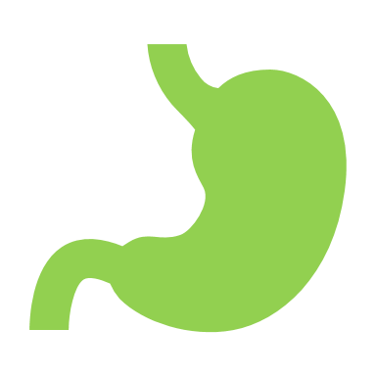
The American Journal of Gastroenterology 116(5):p 899-917, May 2021.

Slide 15
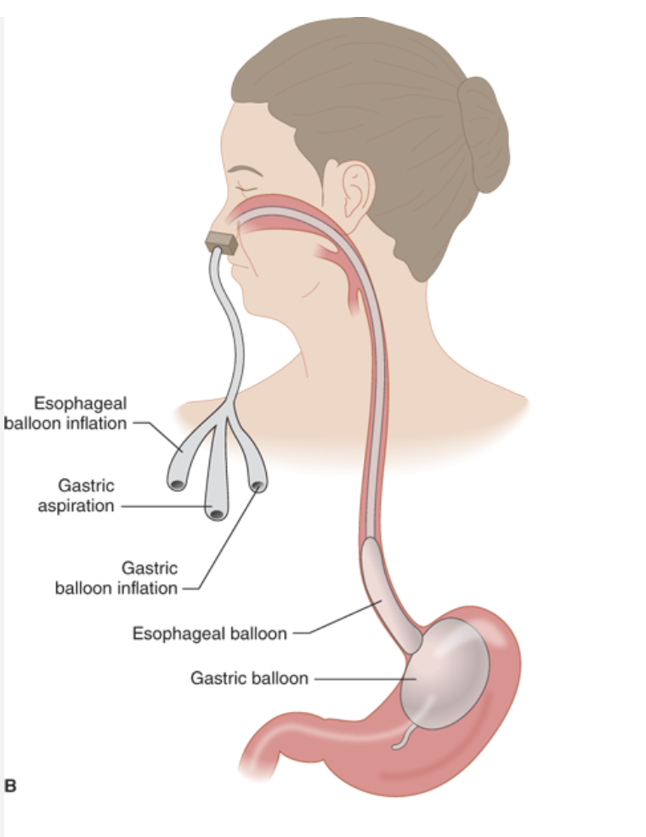
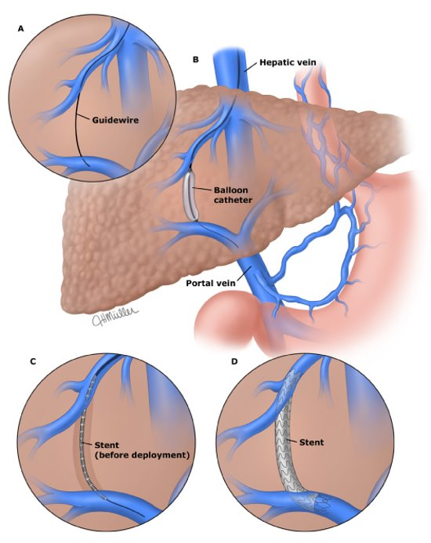
Patients with cirrhosis and acute variceal hemorrhage
Maintain hgb ~ 8g/dL
Short-term abx (max 7d) for any GI hemorrhage
Somatostatin or its analogues should be initiated immediately and continued for 3-5 days
EGD within 12 hours
TIPS if varices not controlled or recurrent bleeding despite pharmacological and endoscopic therapy
Balloon tamponade (max 24h) if uncontrollable bleeding if definitive therapy is planned.
Minnesota tube
TIPS

Slide 16
Ulcer Intervention
Endoscopic
Epinephrine injection
Risk of systemic effects depending on amount and location
Thermal coagulation
Argon Plasma coagulation (APC)
Hemoclips
Can also help to localize lesion if surgery or VIR intervention
VIR embolization
Risk of infarct and perforation
OR for resection

Slide 17
Lower GI Bleed
Colonoscopy
Typical first step, though requires bowel prep and visually limited from blood
Can identify site to assist with further therapy
Few endoscopic intervention options
Tagged RBC
Will allow visualization of entire GI tract
Helpful down to 0.1-0.5 ml/minute bleed
Only diagnostic
Angiography
Requires bleeding rates of 1-1.5 ml/min
Exposes to nephrotoxic iodinated contrast in already high risk patients
Allows for embolization at time of diagnosis
Surgery reserved for refractory cases

Slide 18
Summary
Can never have too much IV access
Early consultant involvement
Medically stabilize
Minimize transfusions—Goal Hgb >7
Replace coagulation factors, platelets, consider DDAVP

